Slide 1
WebQuiz Prototype
Green arrows indicate where you should click to continue with the prototype. If there are more than one arrows then you can click either.

Slide 2
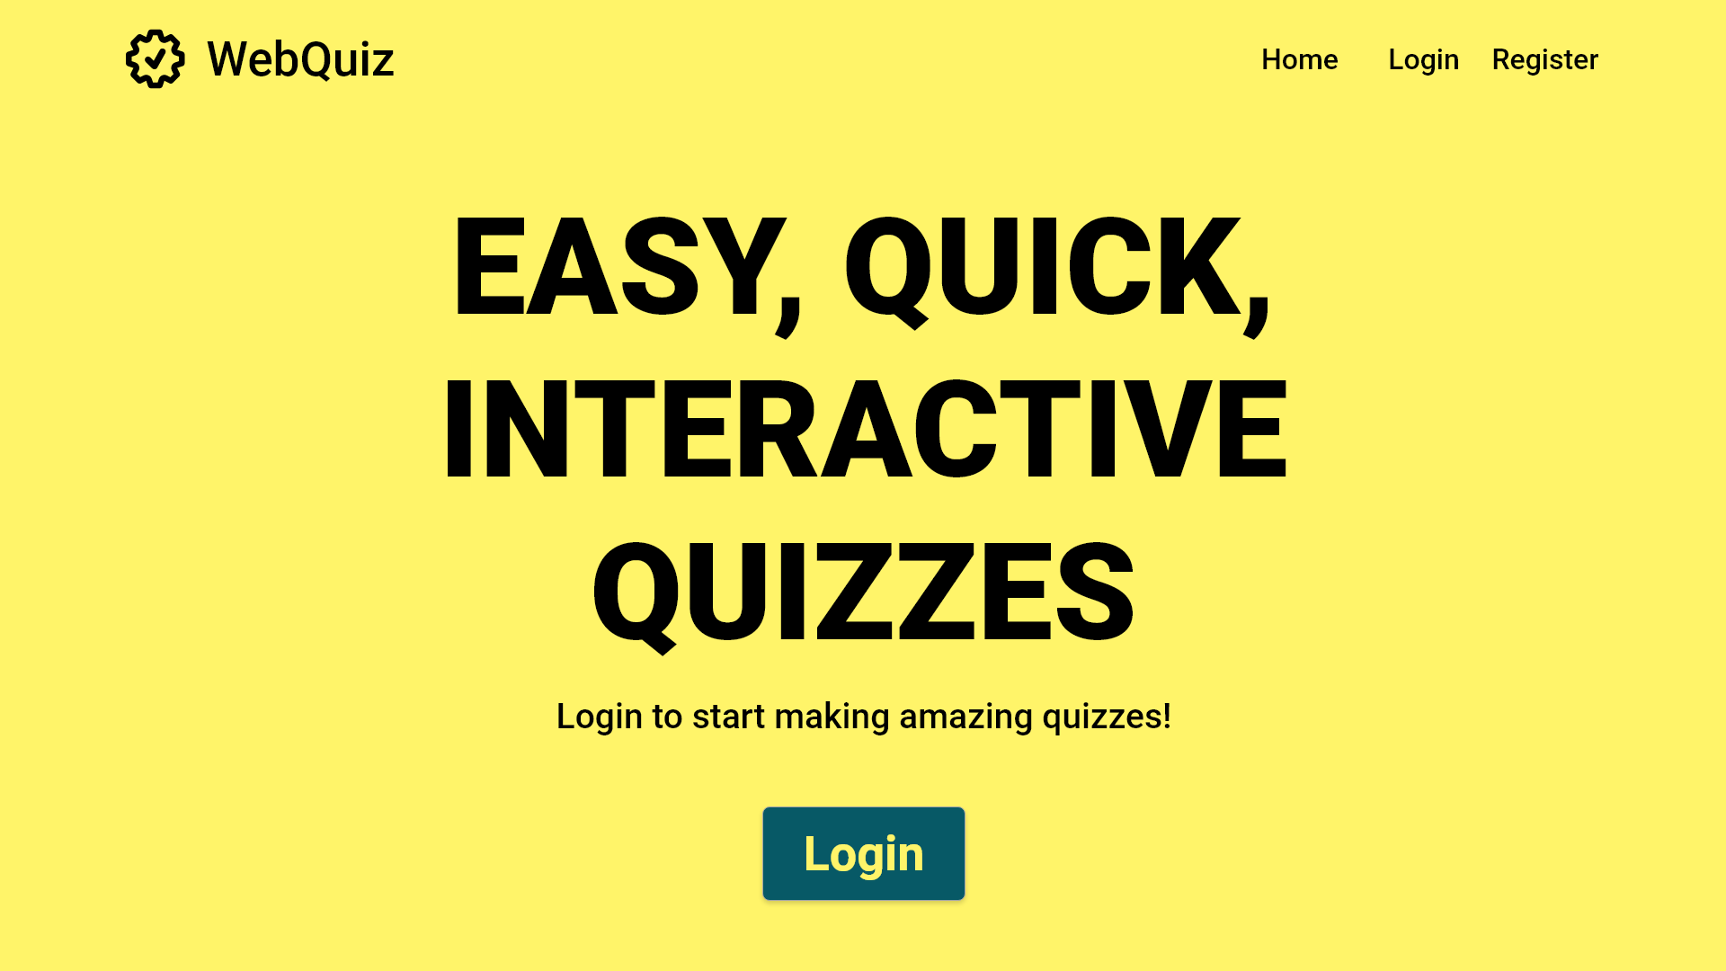
If the Quiz Maintainer does not have an account, one can be registered here

Slide 3
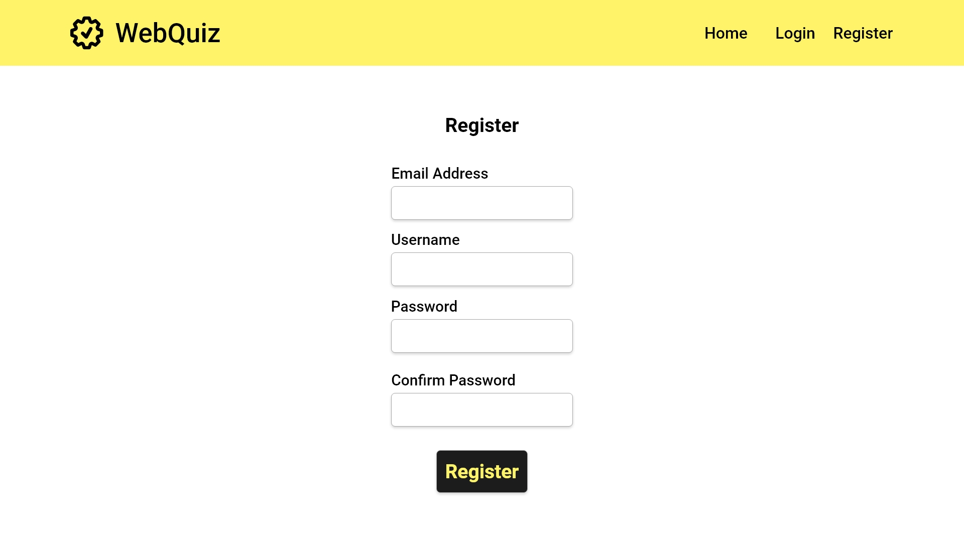
UC1.0
Quiz Maintainer account creation
Start Register
User fills in text boxes
UC2.0
Quiz Master account creation
Click the button once forms are filled
Error case

Slide 4
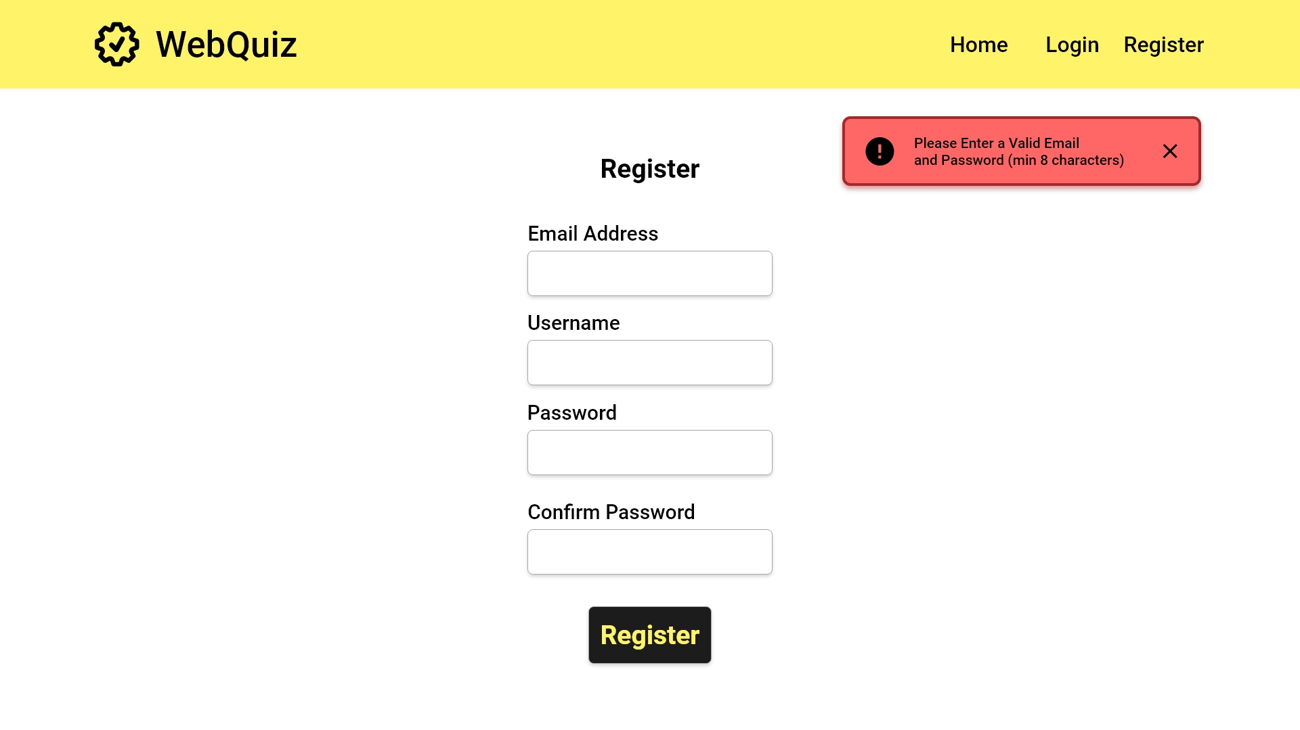
Email must be in proper email format
Password must be 8 or more characters long
An error message will be returned if either box is left blank
EC1.0
Quiz Maintainer registration error: no details
EC1.1
Quiz Maintainer registration error: invalid details

Slide 5
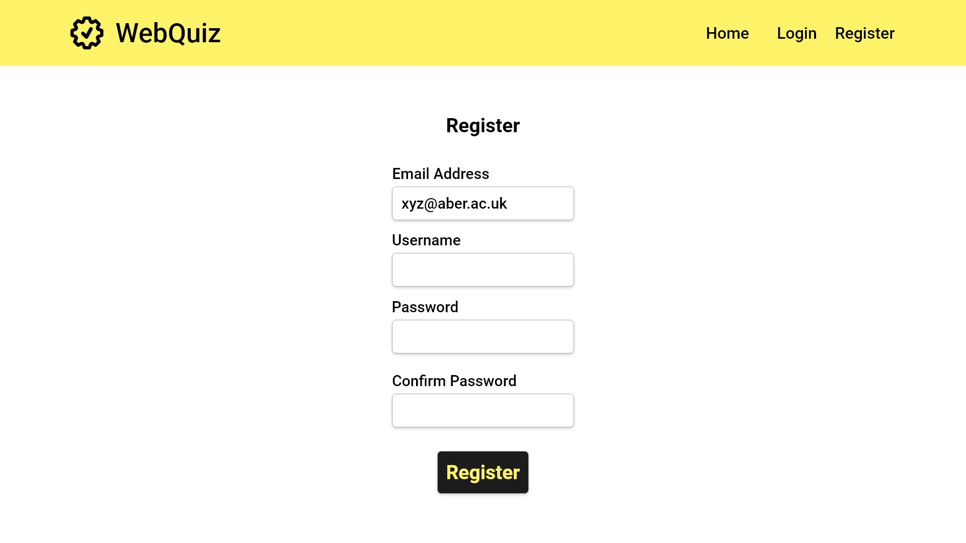

Slide 6
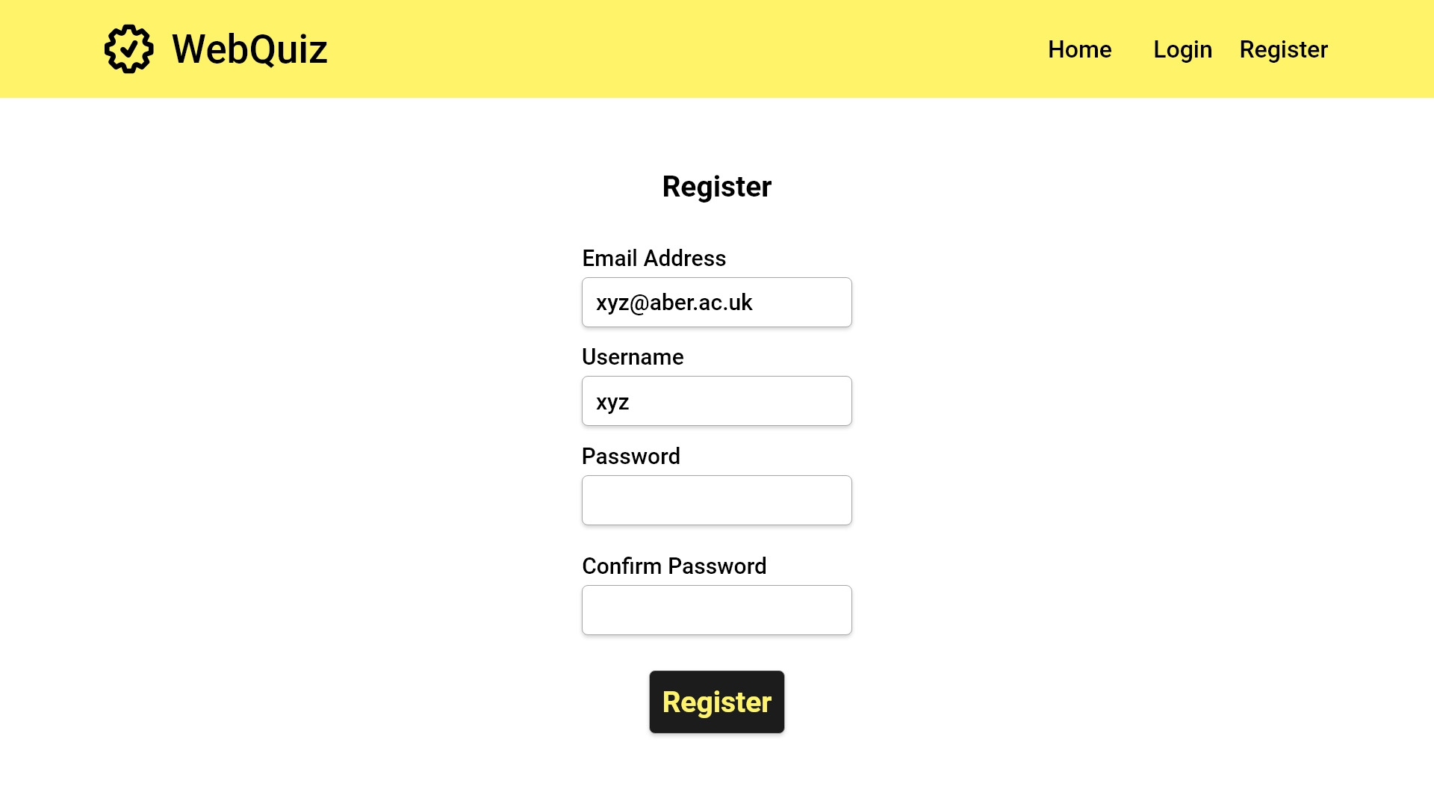

Slide 7


Slide 8


Slide 10
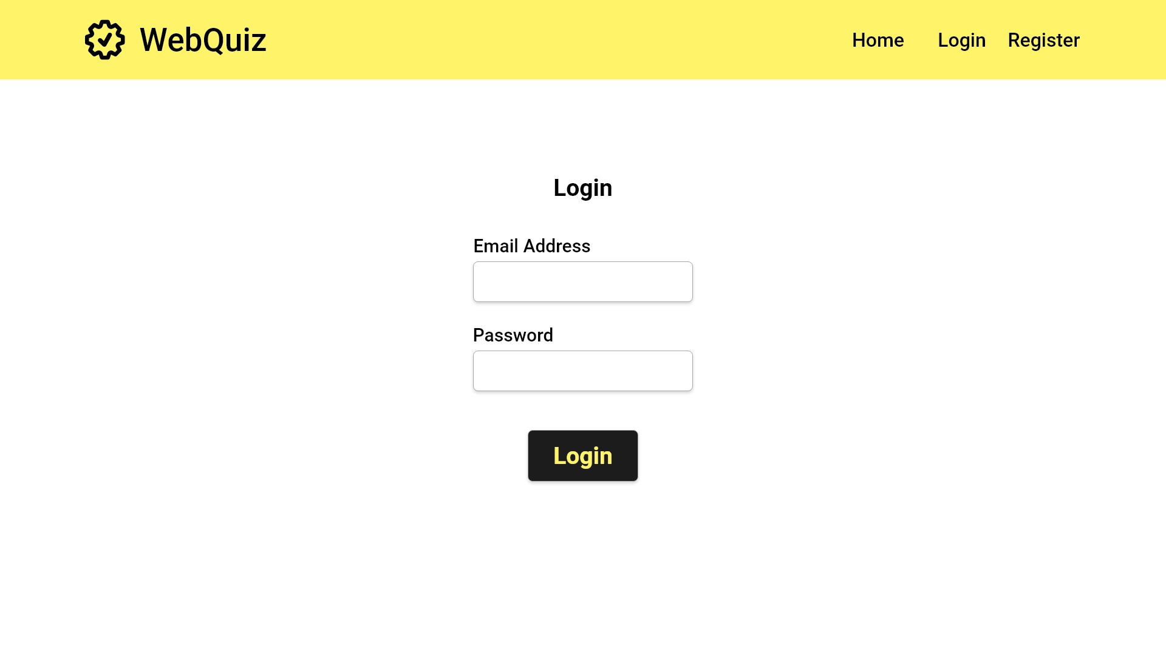
UC1.1
Quiz Maintainer login
UC2.1
Quiz Master login
Error Case

Slide 11
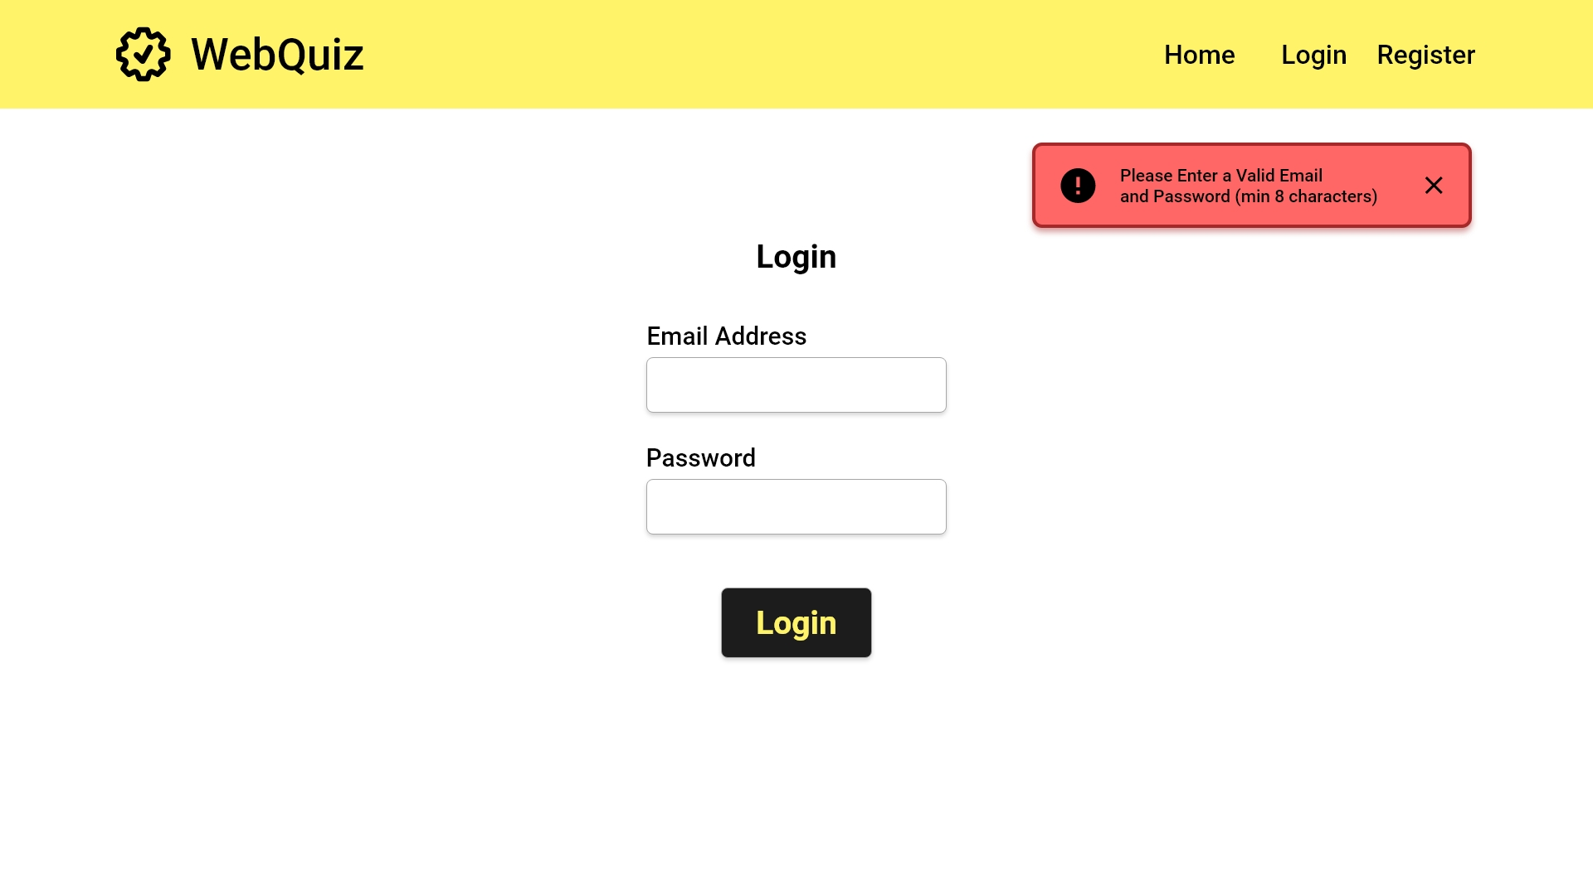
EC1.2
Quiz Maintainer login error: no details

Slide 13
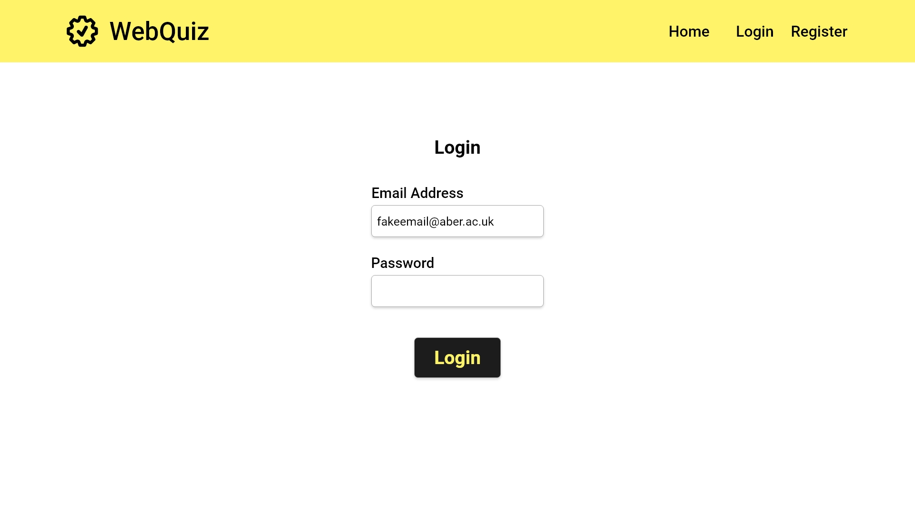

Slide 14
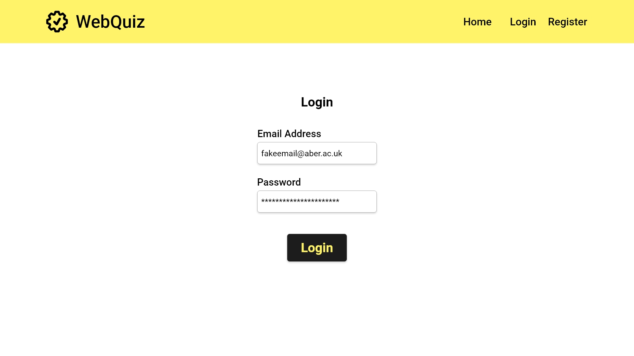

Slide 15
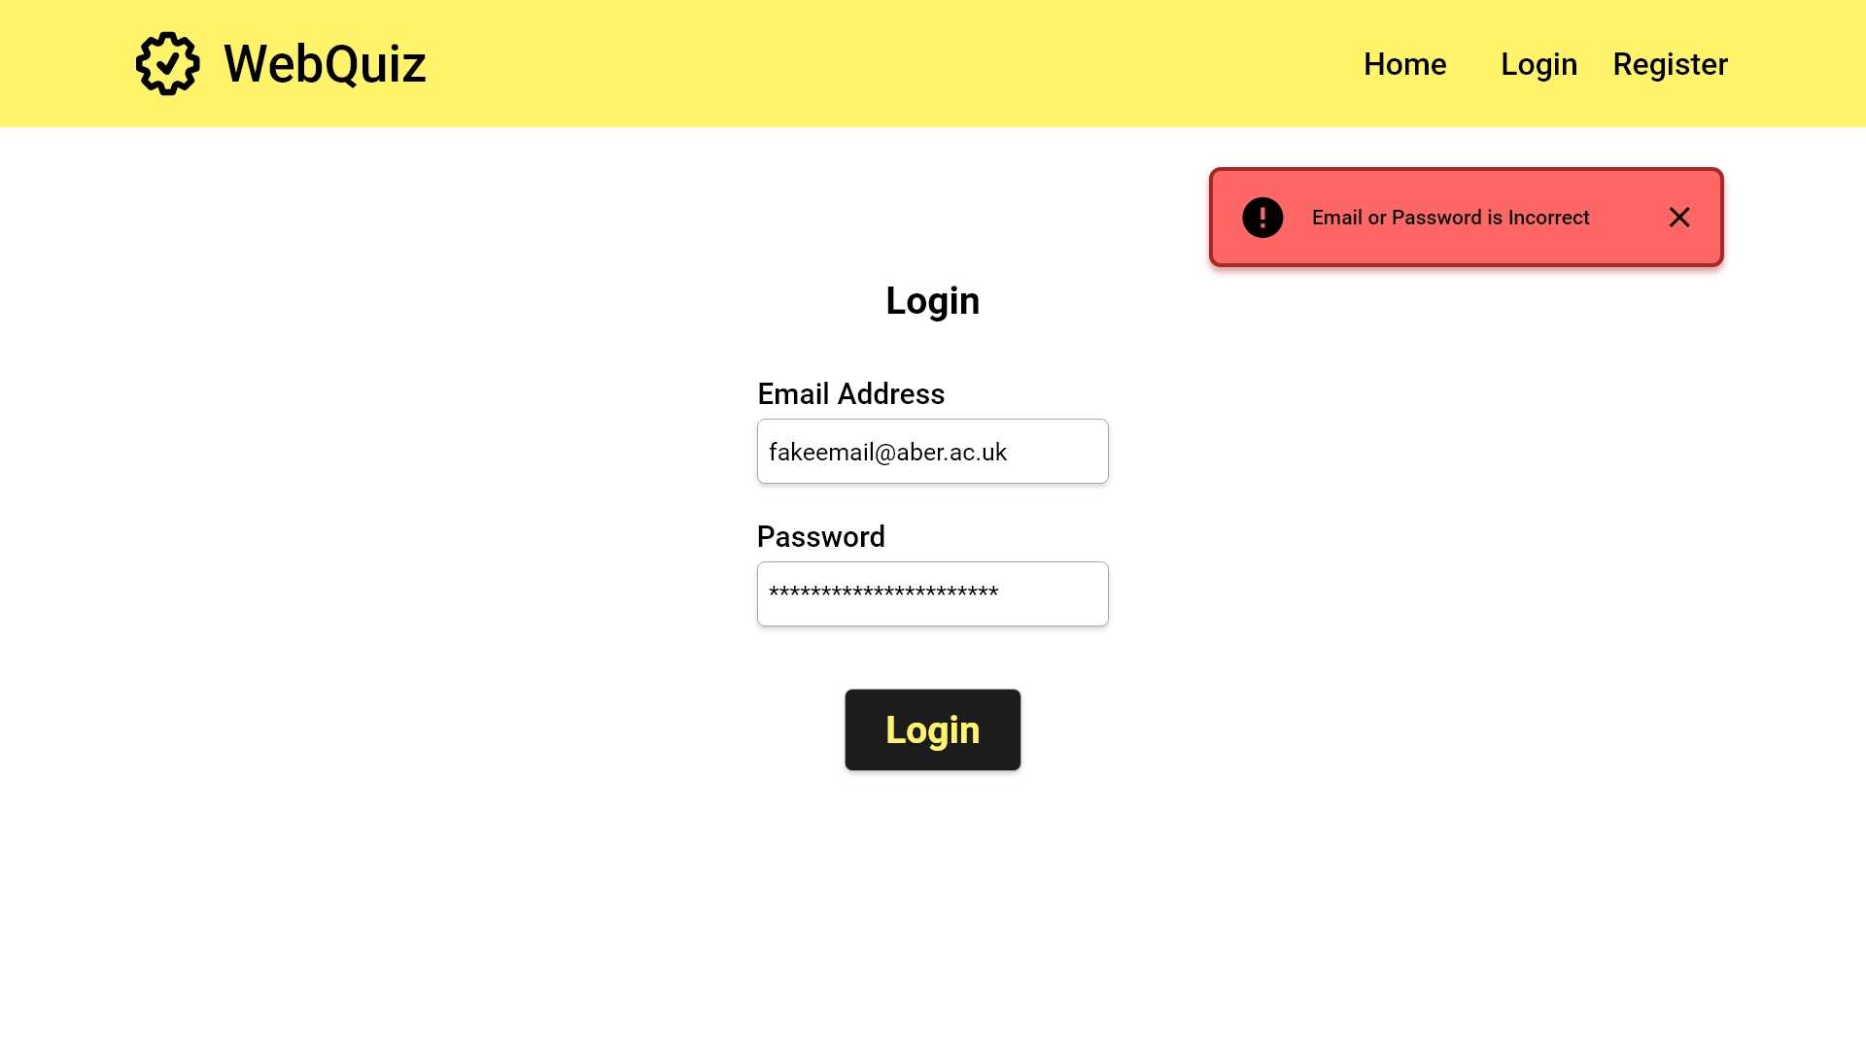
EC1.3
Quiz Maintainer login error: invalid details

Slide 16


Slide 17
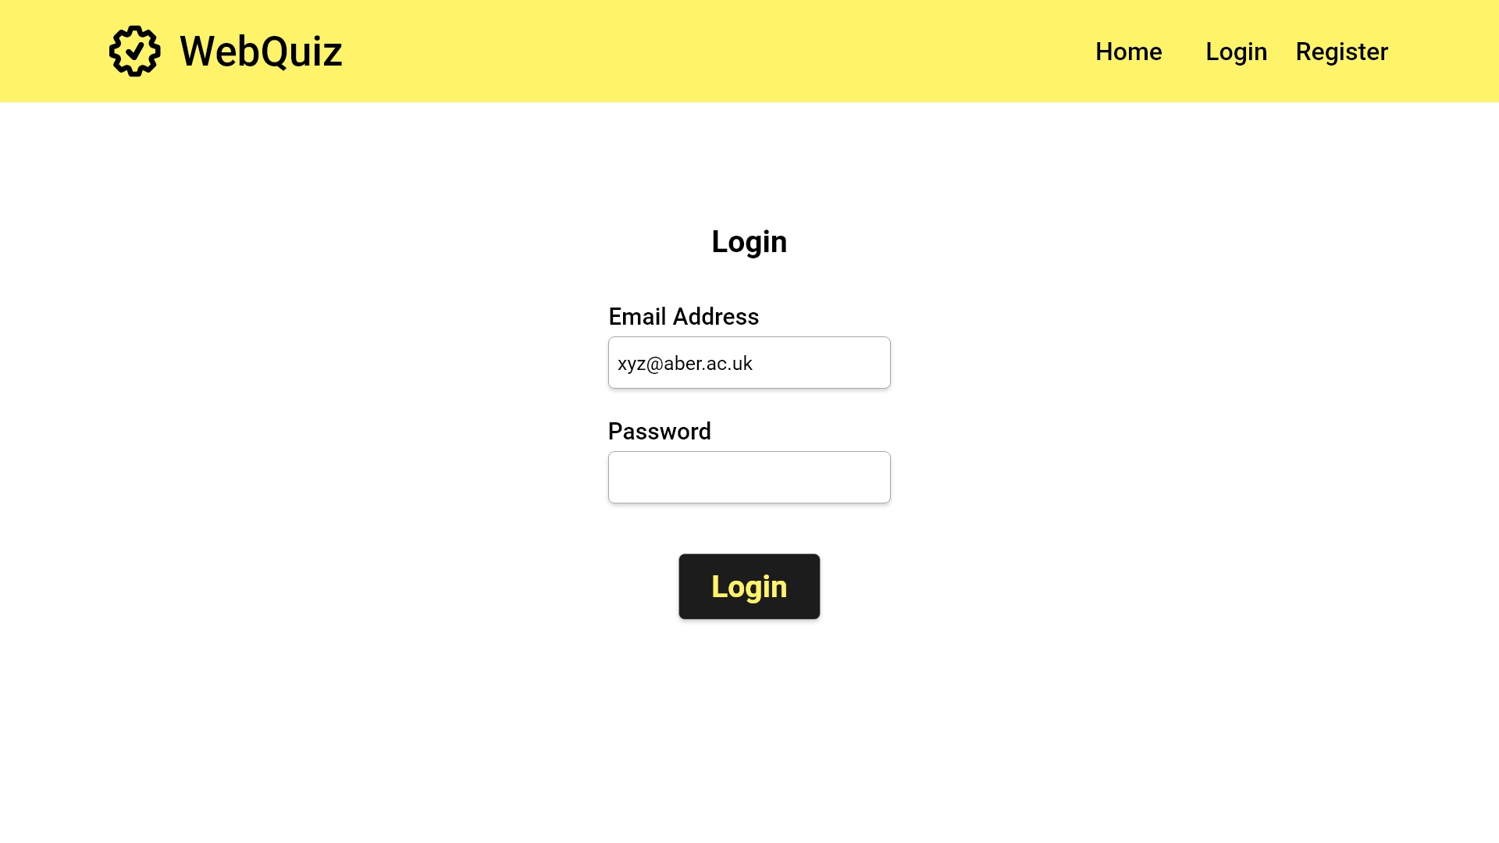

Slide 18


Slide 19
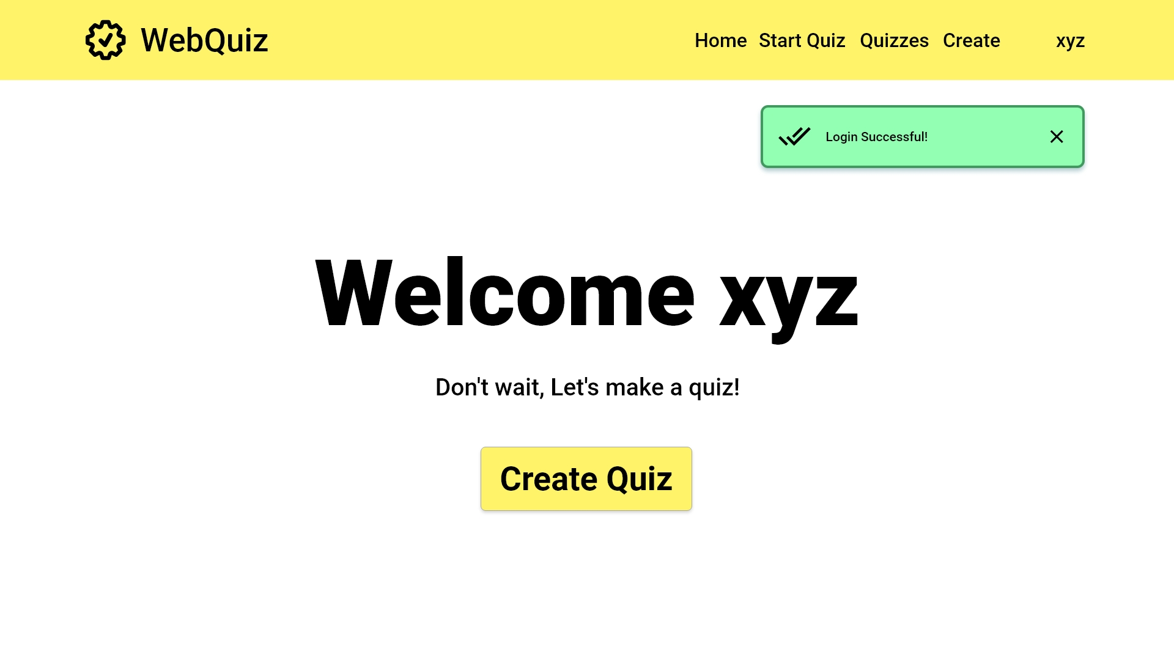
Close success message
Start Quiz Creation

Slide 20
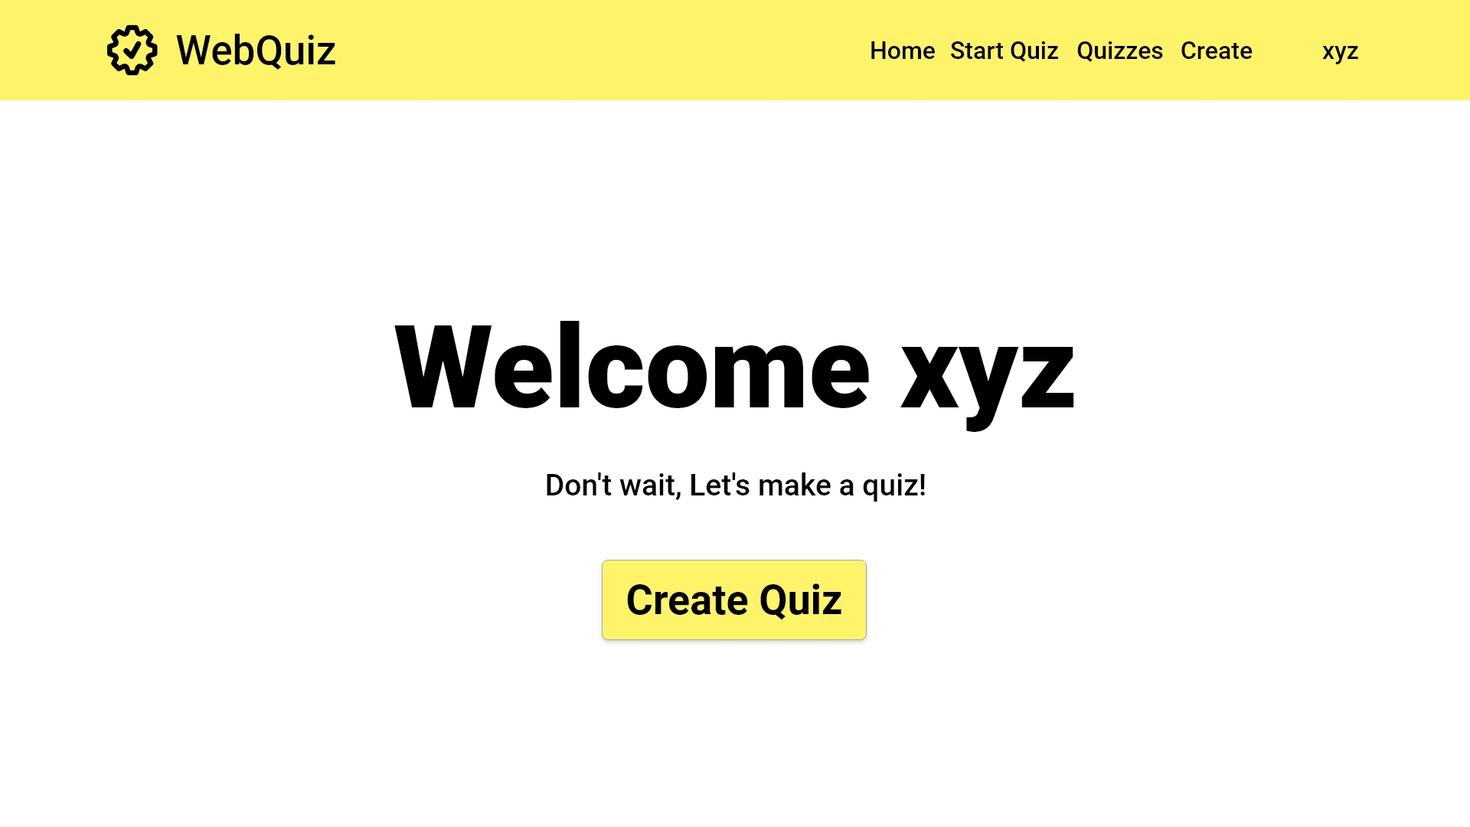
Start Quiz Creation
Start Quiz Creation
Switch to mobile view

Slide 21
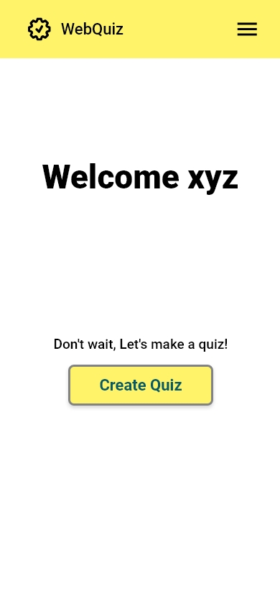
EIR2 Responsive web design
Switch to desktop view

Slide 22
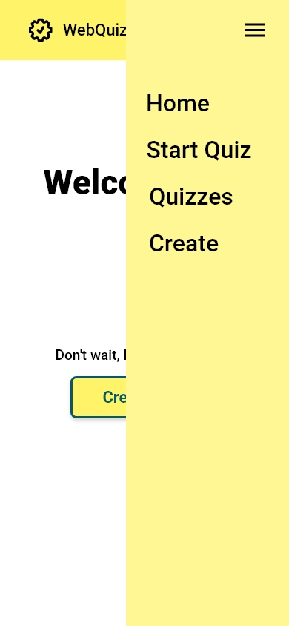
Switch to desktop view

Slide 23
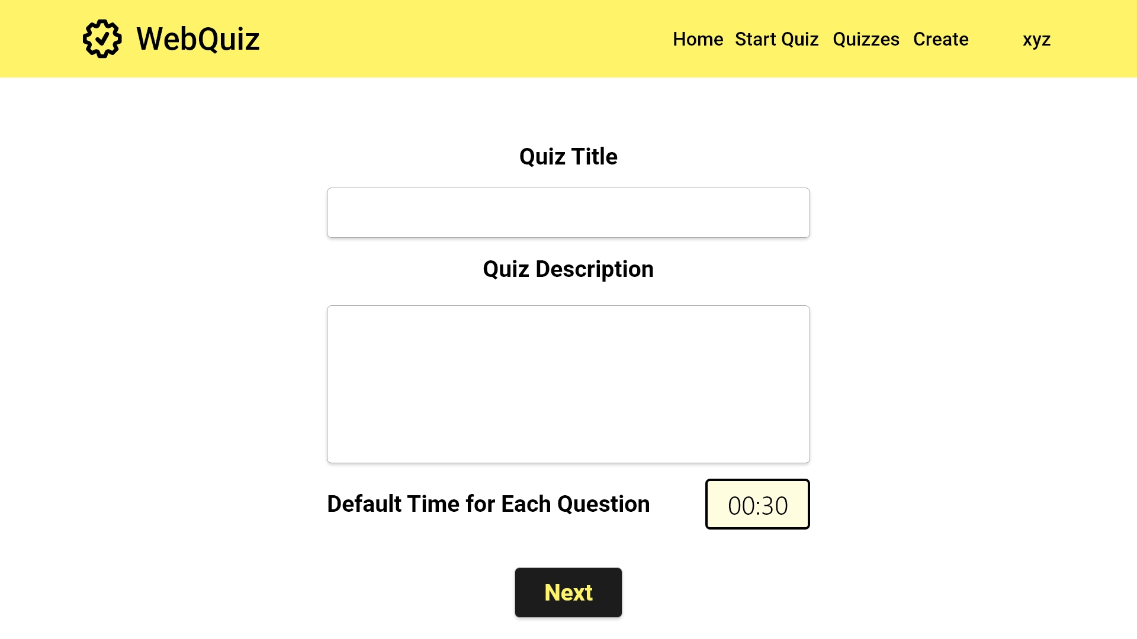
[FR1]: The quiz maintainer is able to create a quiz with a title
[FR1]: The quiz maintainer can enter a description for the quiz here
USE CASE 1.2
Quiz Maintainer create quiz
[FR4]: The default question time is 30; this can be altered

Slide 24
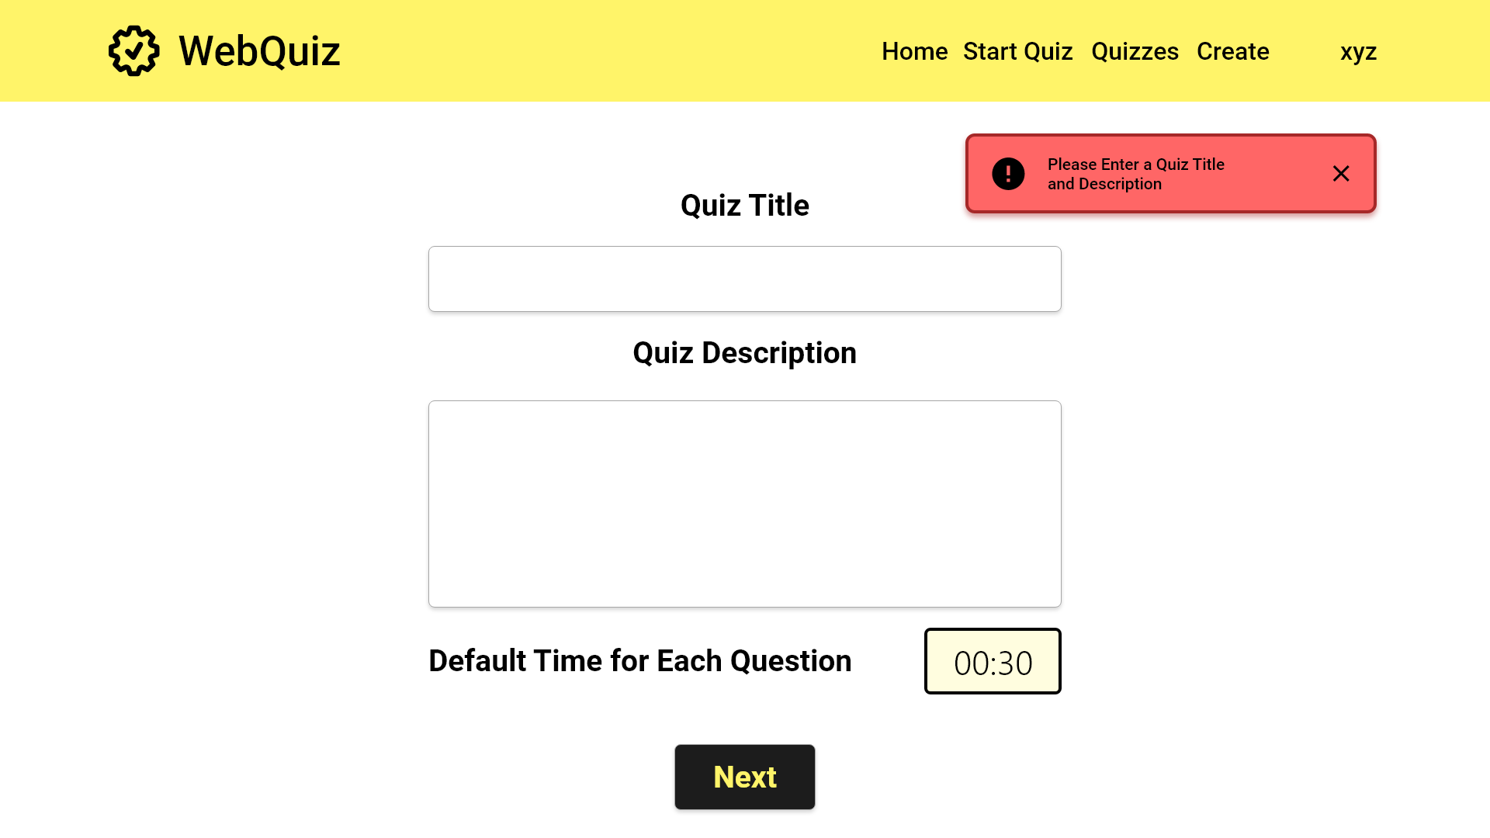
EC1.4
Quiz Maintainer quiz creation: blank
[FR1] Check if the title to the new quiz is given

Slide 25
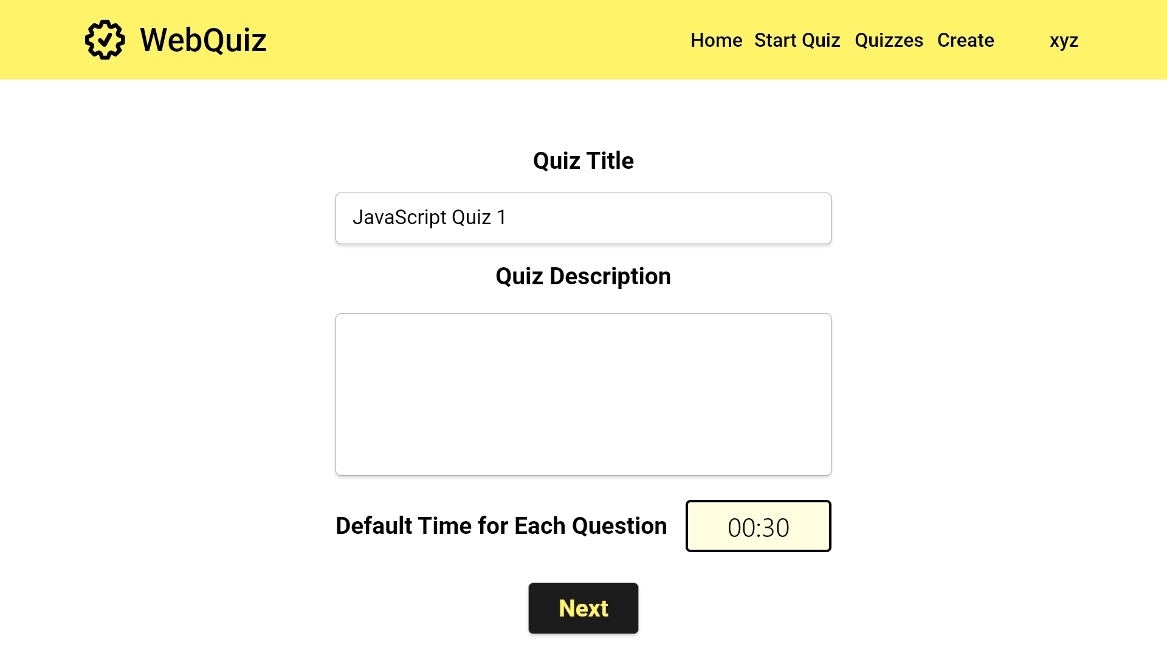

Slide 26
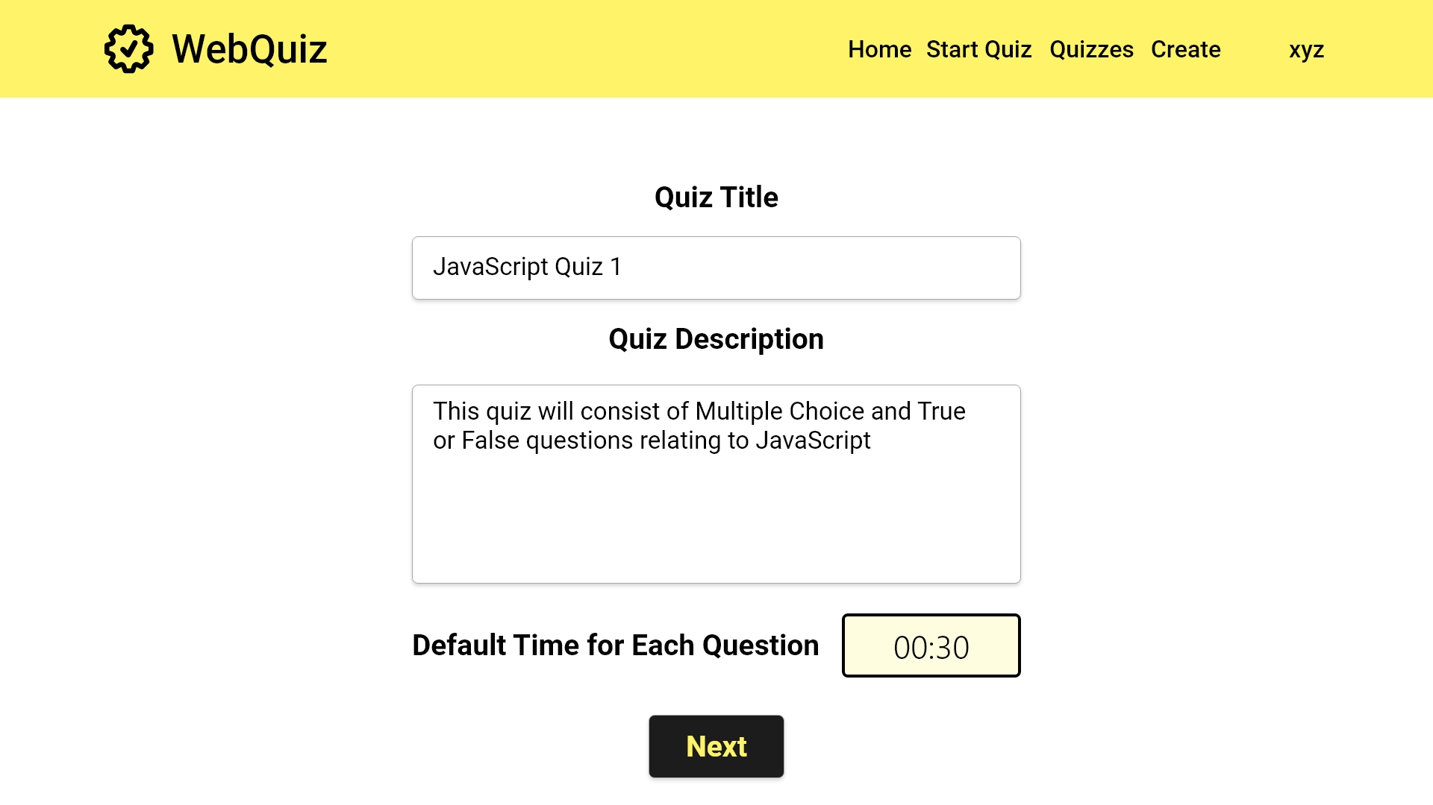

Slide 27
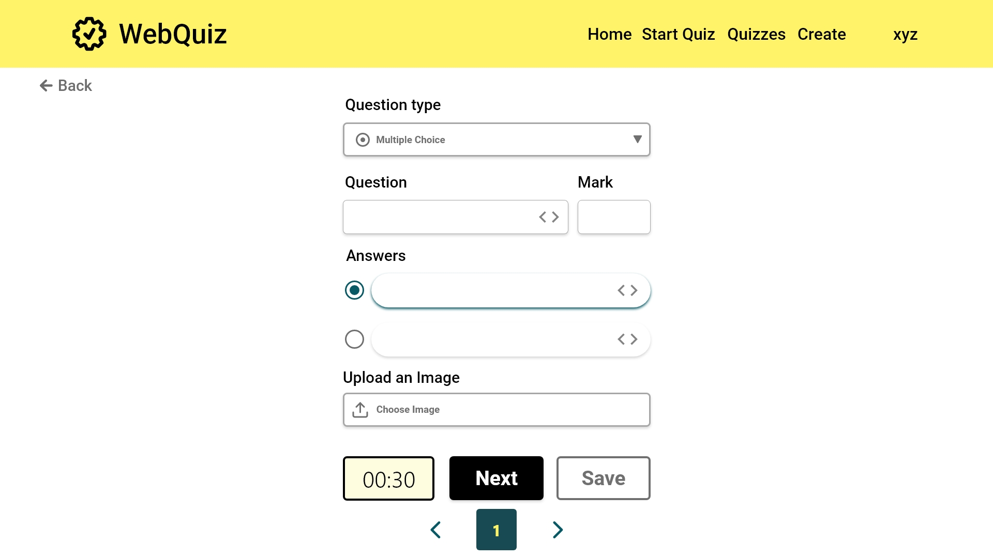
UC1.2
Quiz Maintainer create quiz
[FR2]: The quiz maintainer can create a multiple choice quiz
[FR2]: A mark can be set for the question here
[FR2]: A question must be entered in the box
[FR2]: Multiple choices can be set. The minimum is 2. Check the correct answers
[FR2]: An accompanying image can be uploaded
[FR4]: The default timer is applied. This can be changed on as needed
Error case

Slide 28
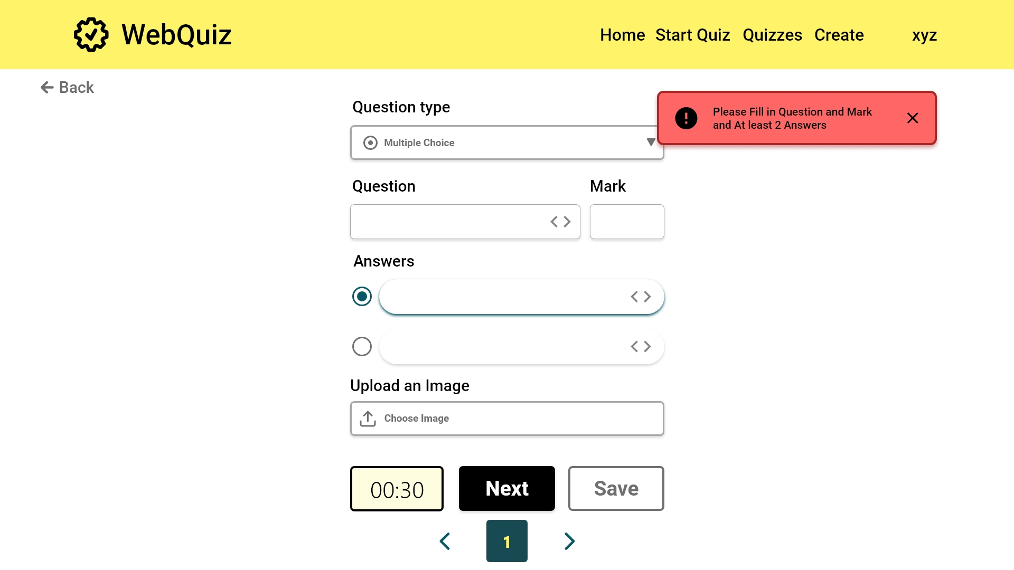
EC1.5
Quiz Maintainer quiz creation: multiple choice
[FR2] Check if the new question has the question text, two or more possible answers, an indication of which answers are correct, a mark for each

Slide 29


Slide 30


Slide 31


Slide 32
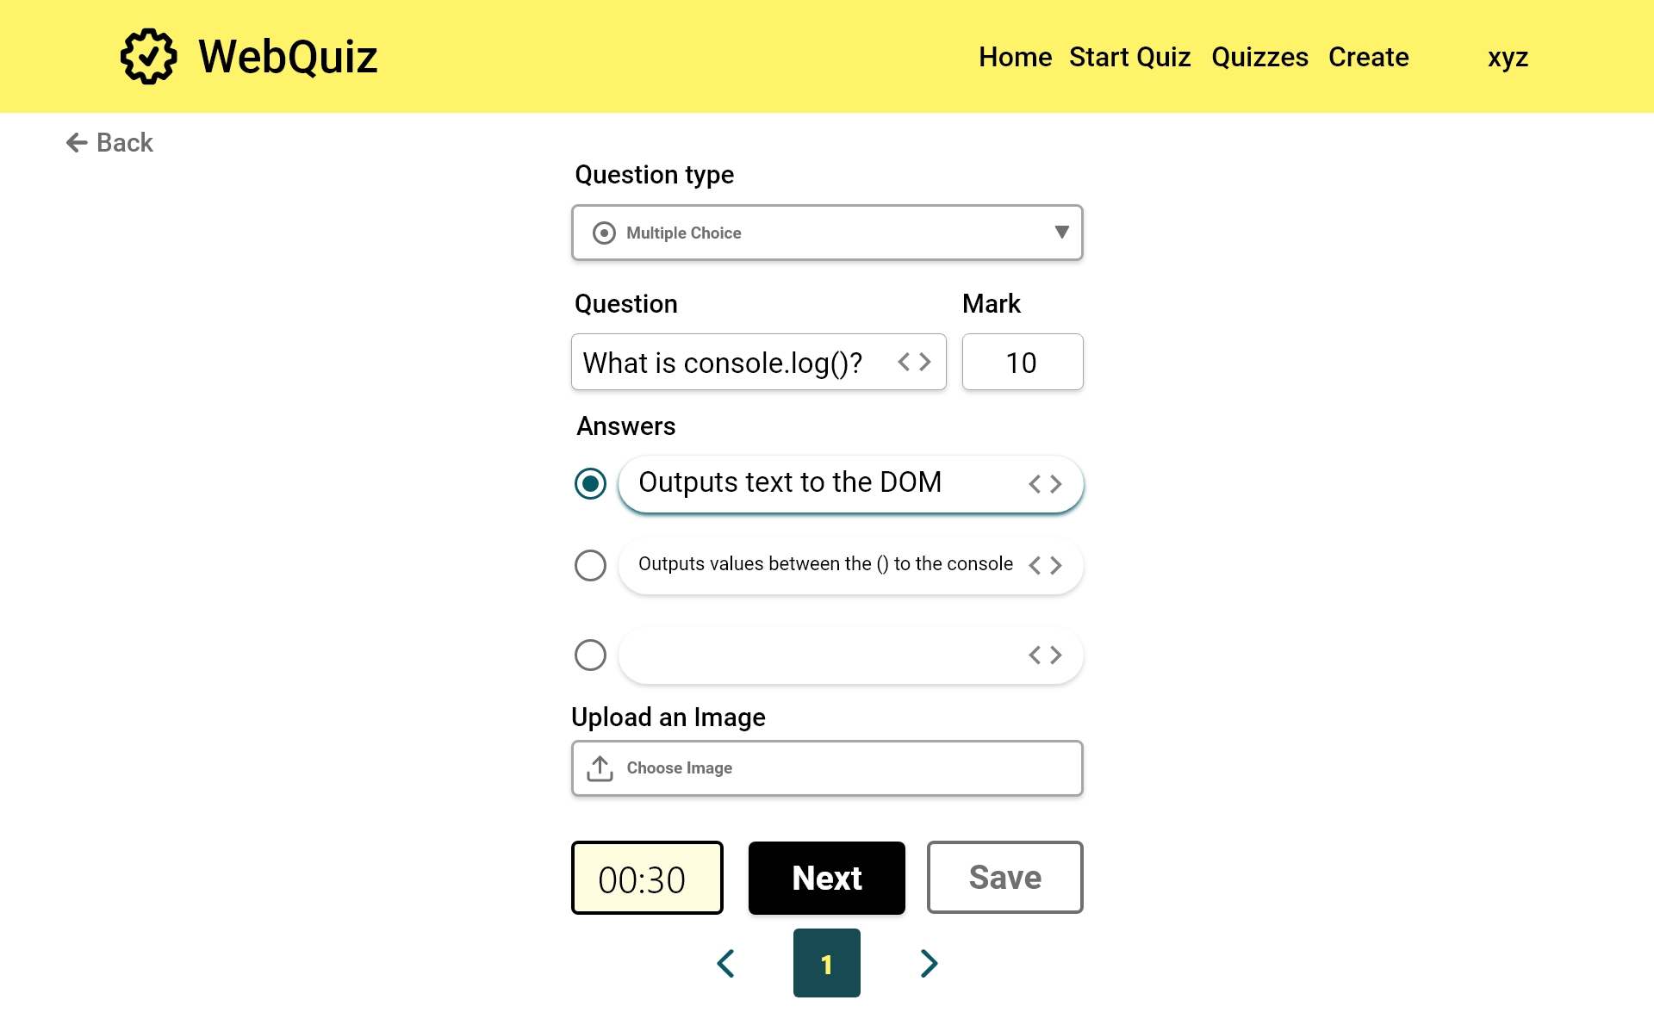
[FR2]: Additional answers are added as needed

Slide 33
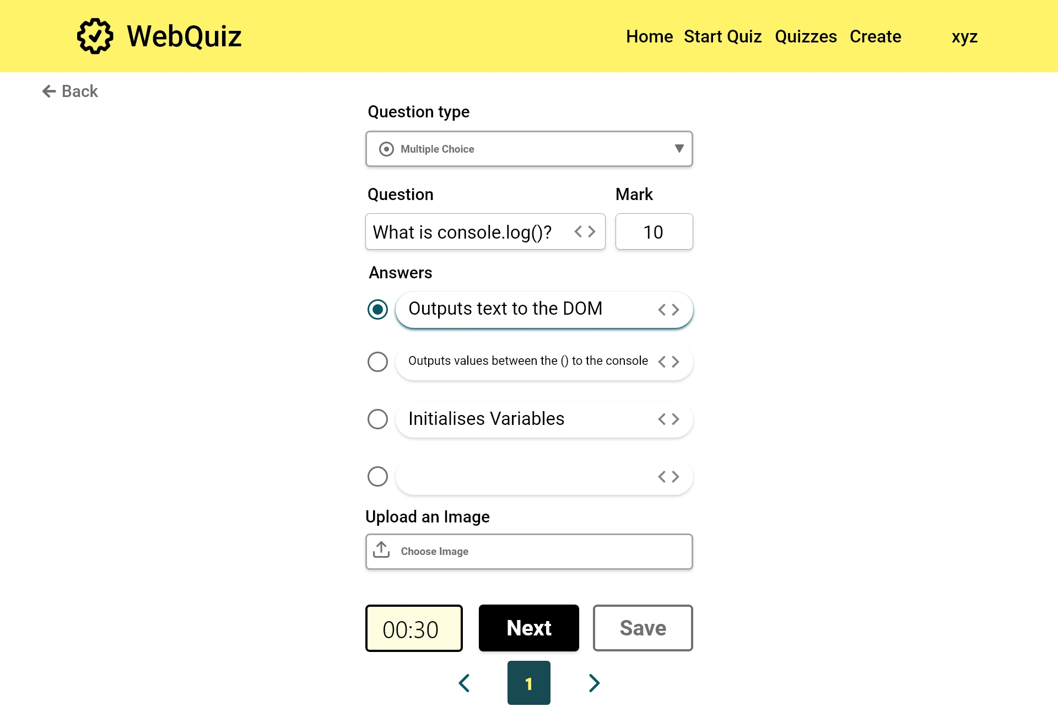
[FR2]: Additional answers are added as needed

Slide 34
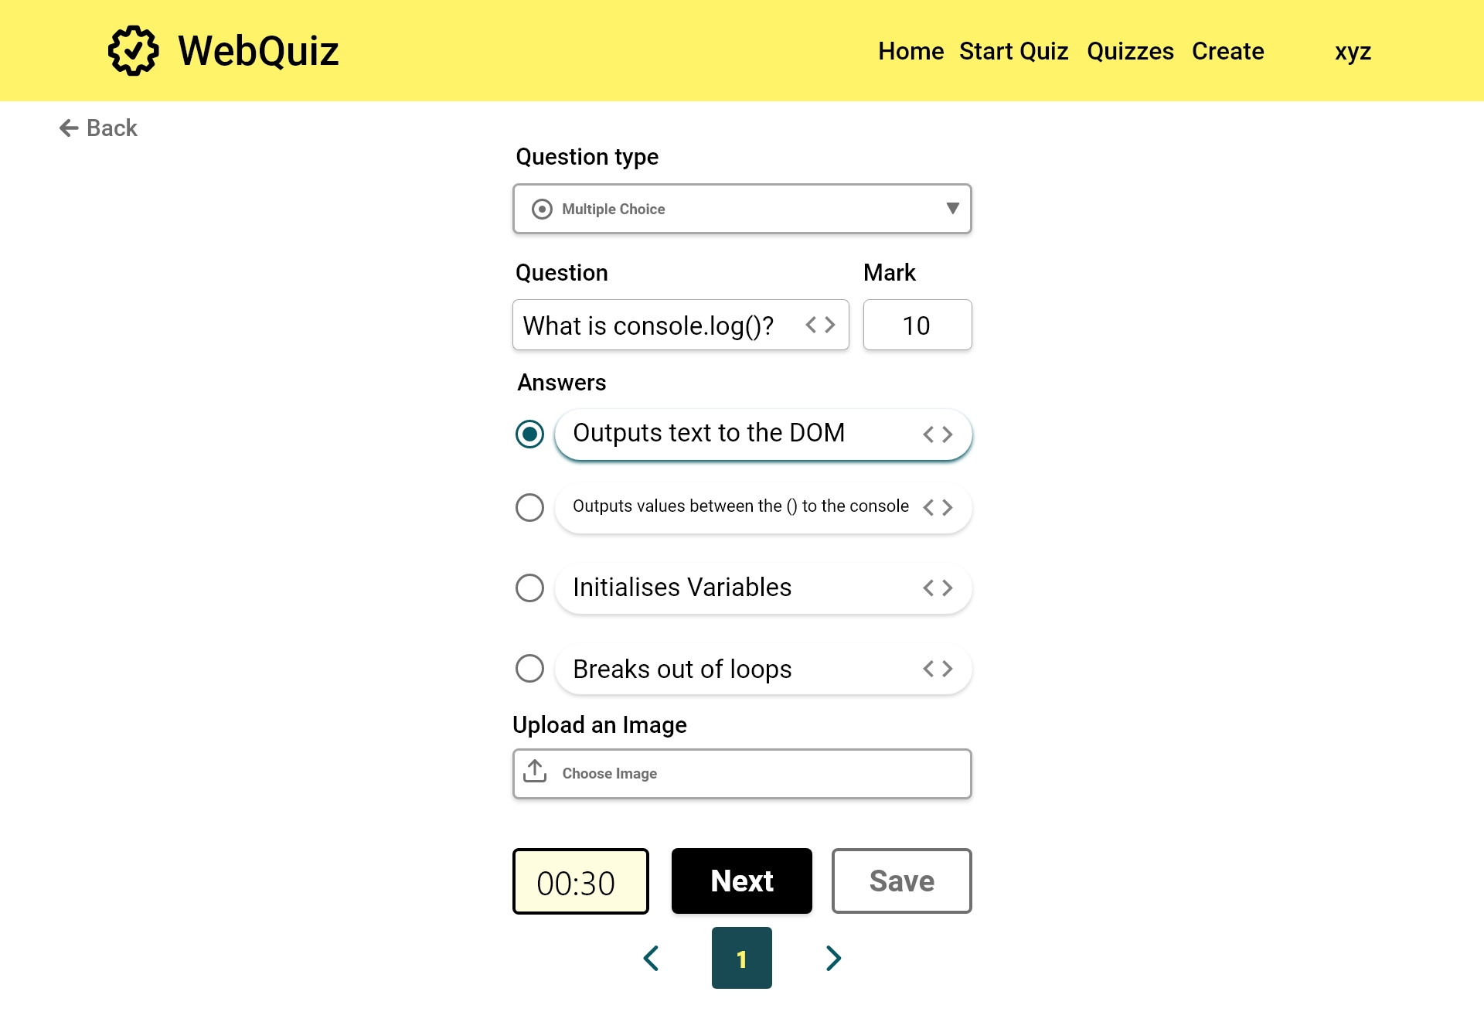
[FR2] Indicate a correct answer

Slide 35
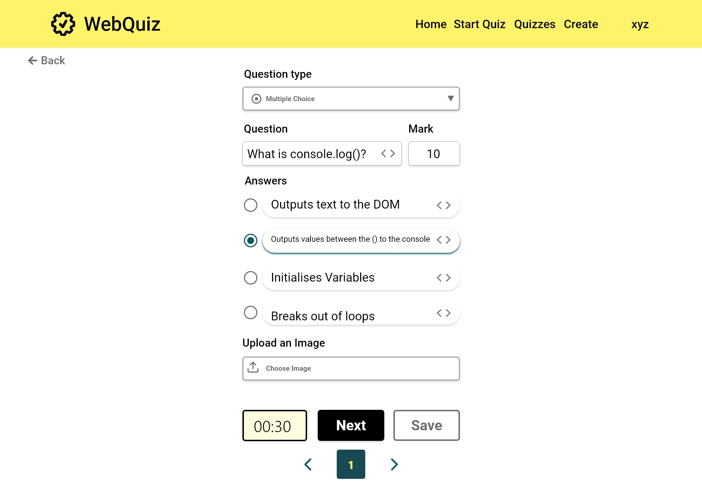

Slide 36
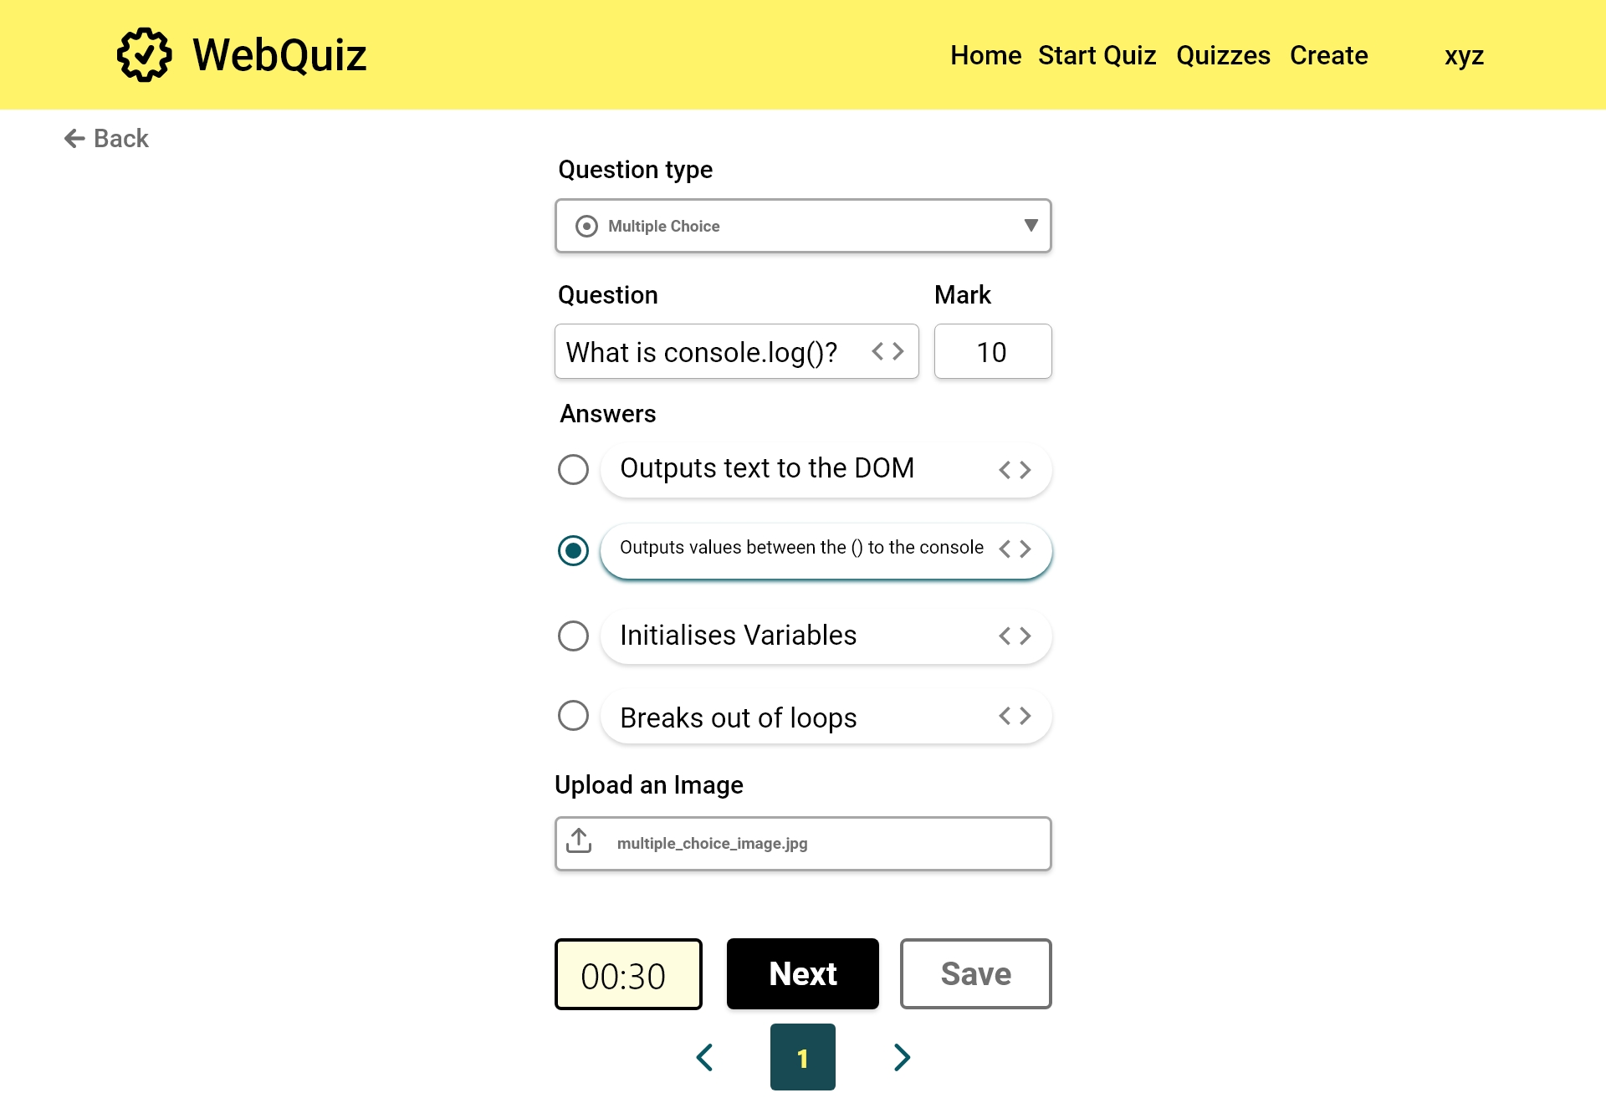

Slide 37
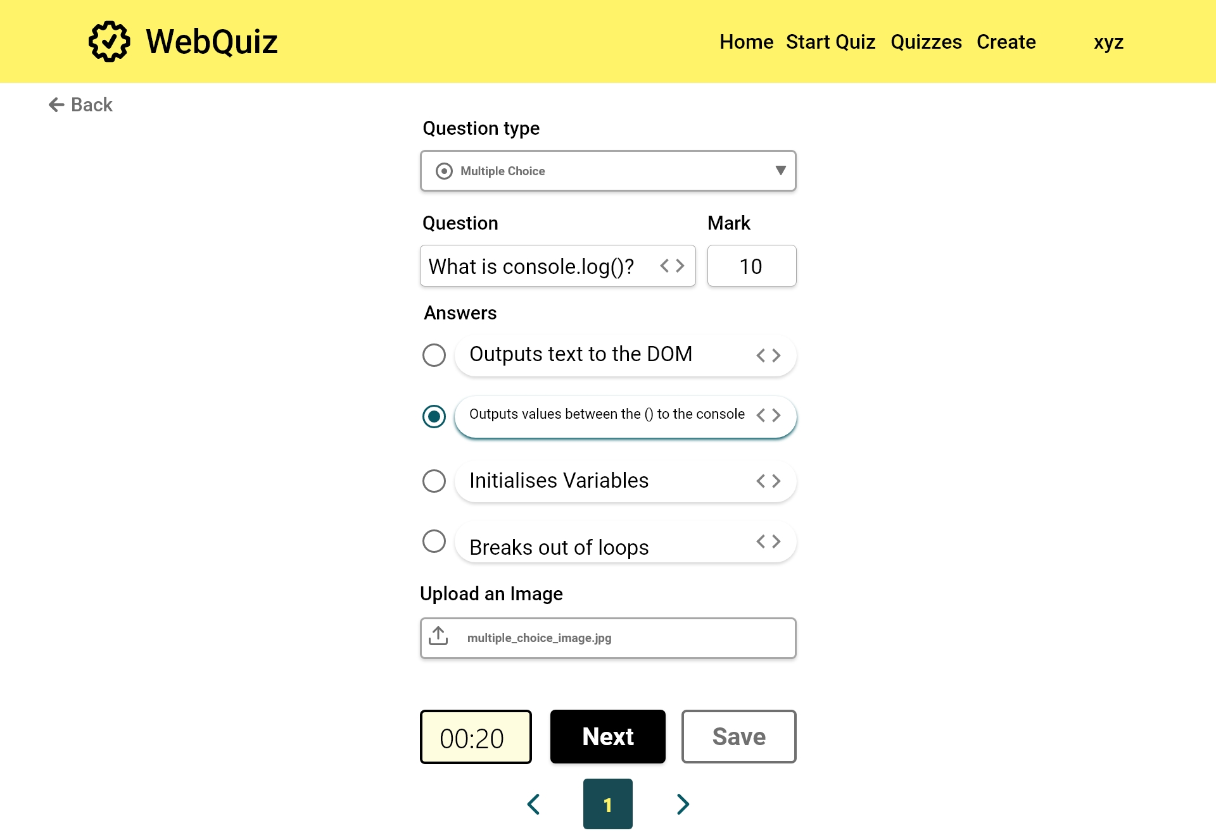

Slide 38
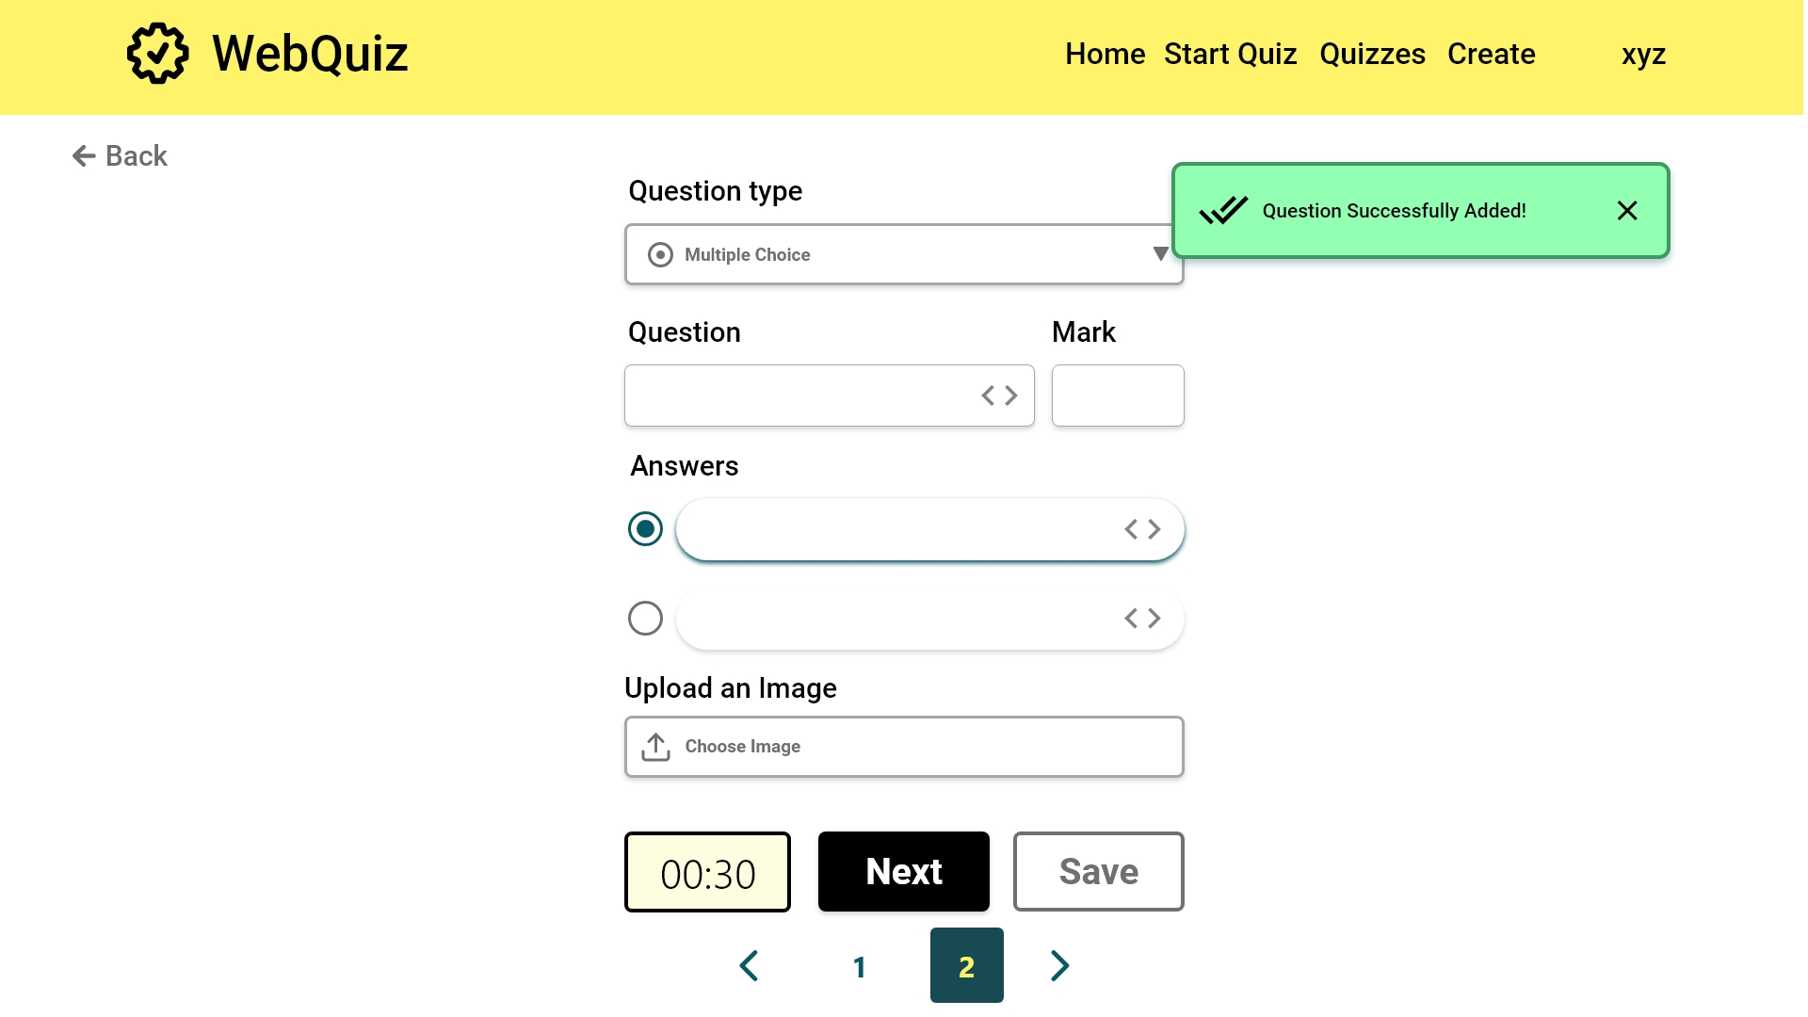
[FR6]: The navigation bar can be used to edit questions

Slide 39
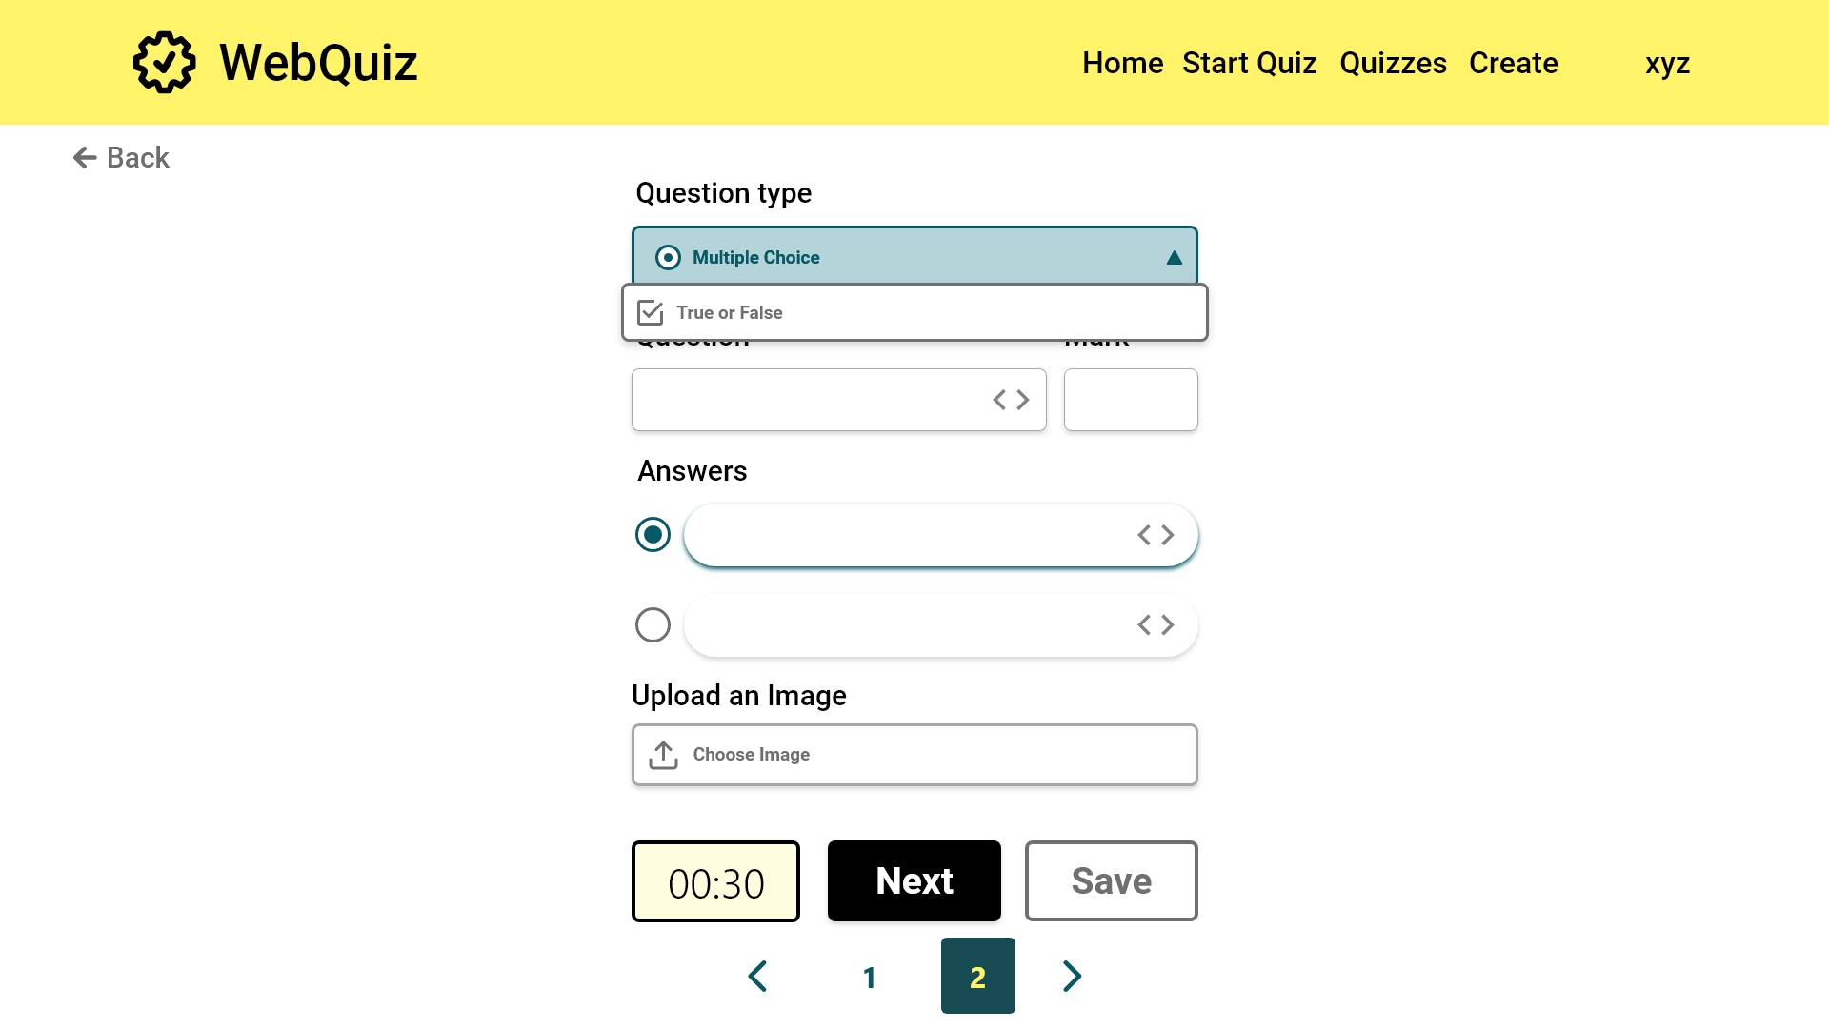
[FR3]: The quiz maintainer can choose to create a true or false question

Slide 40
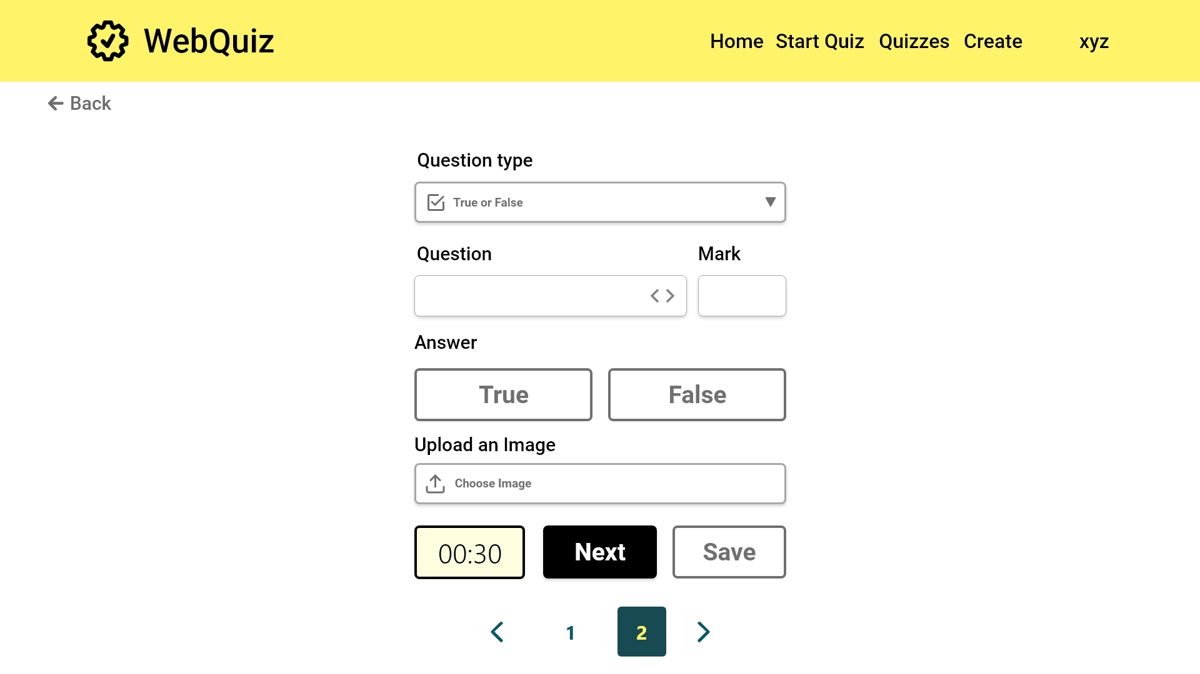
[FR4]: The user interface changes to accommodate the change in question type
[FR4]: The quiz maintainer can choose whether the answer is true or false
Error case

Slide 41
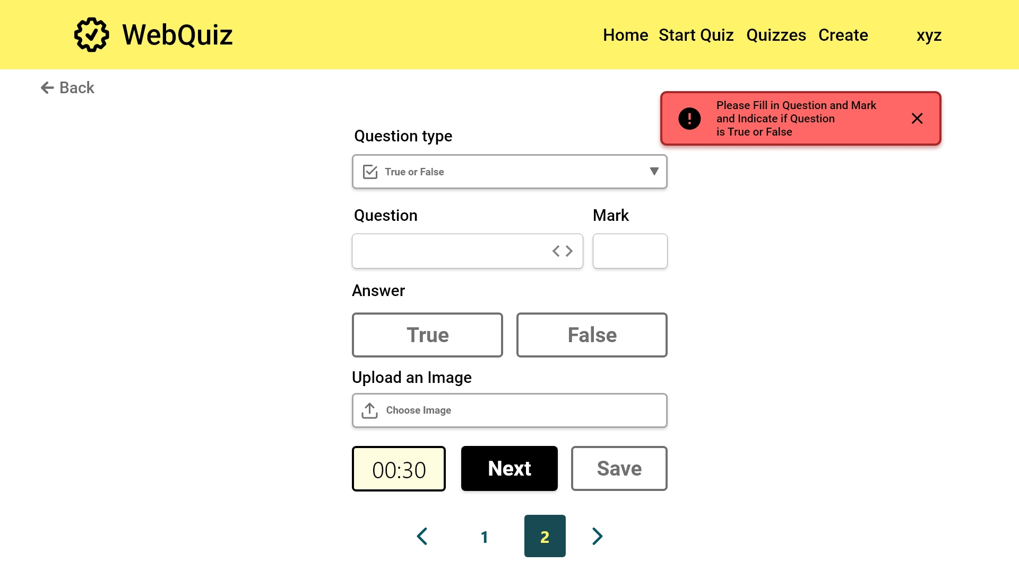
EC1.6
Quiz Maintainer quiz creation: multiple choice
[FR3] Check if the new question has the question text, an indication of whether the answer should be true or false and a mark for each

Slide 42
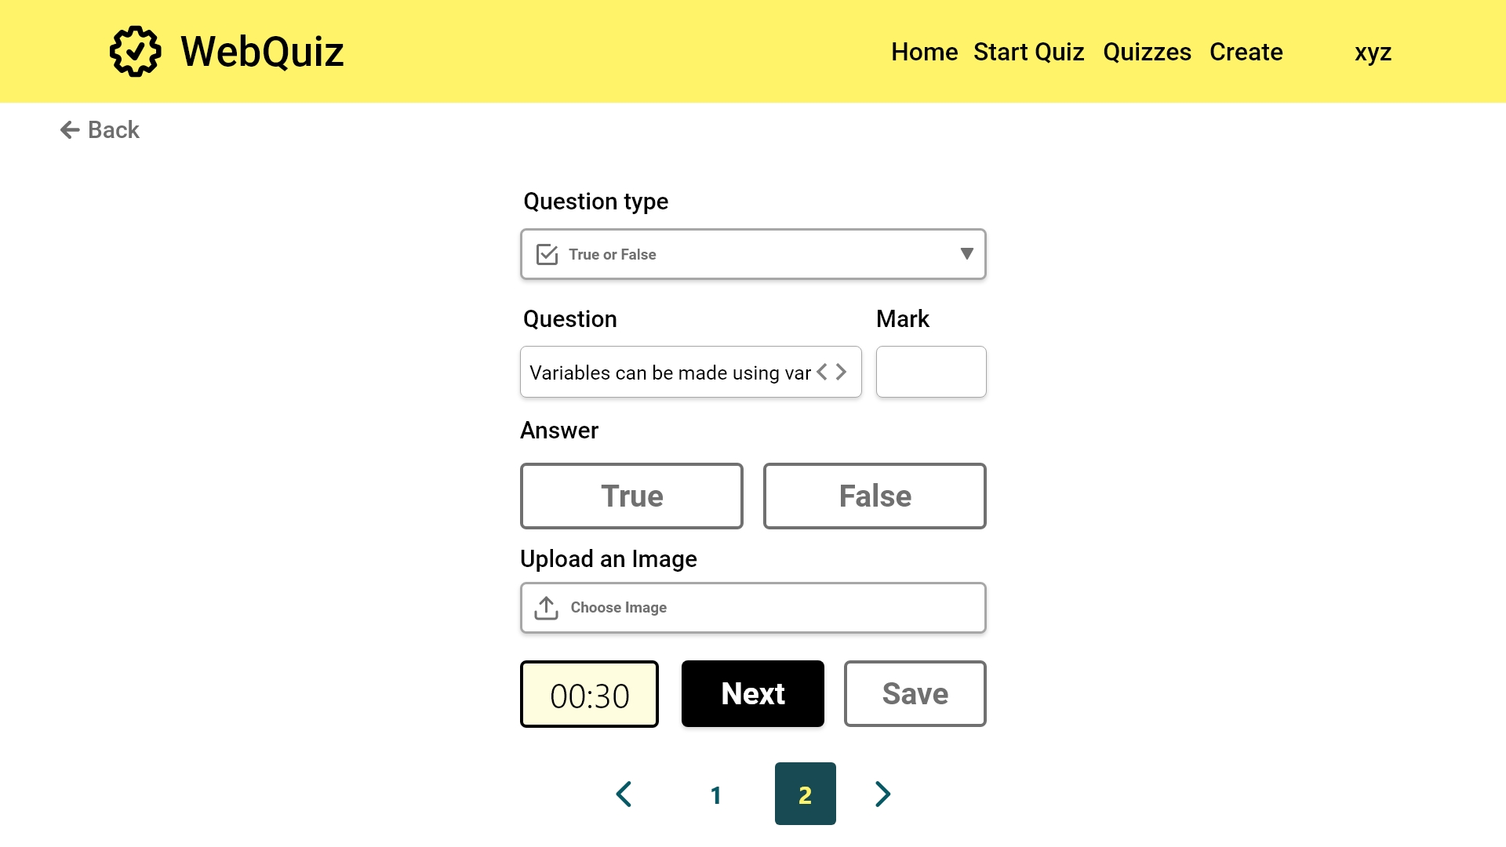

Slide 43



Slide 44
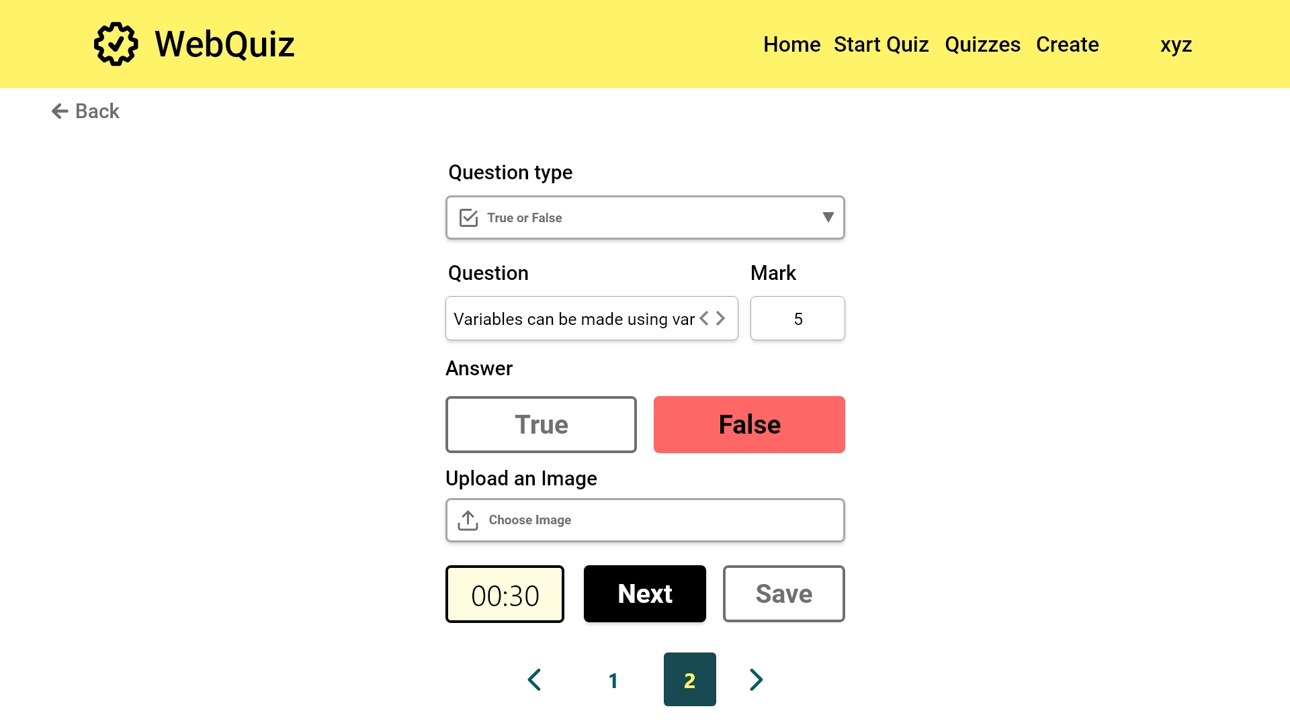

Slide 45
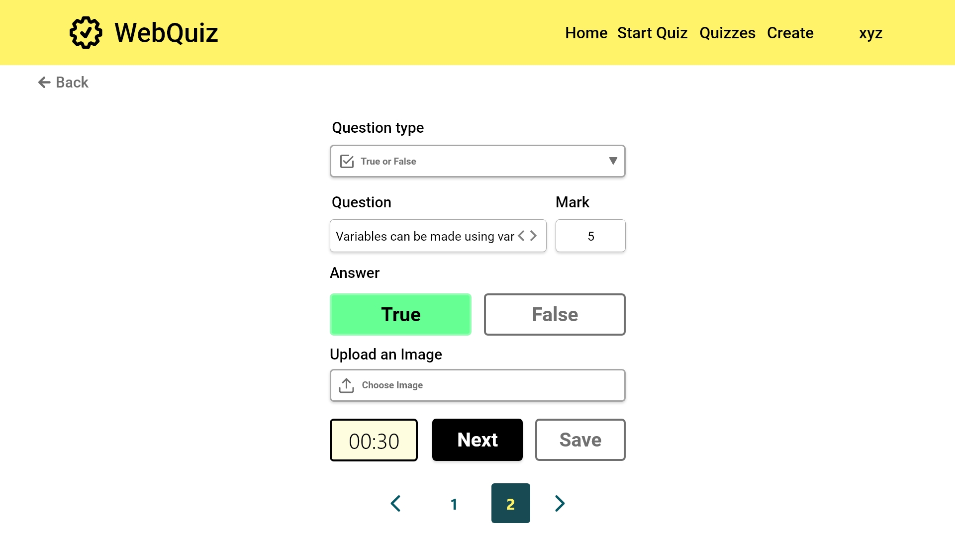

Slide 46


Slide 47


Slide 48
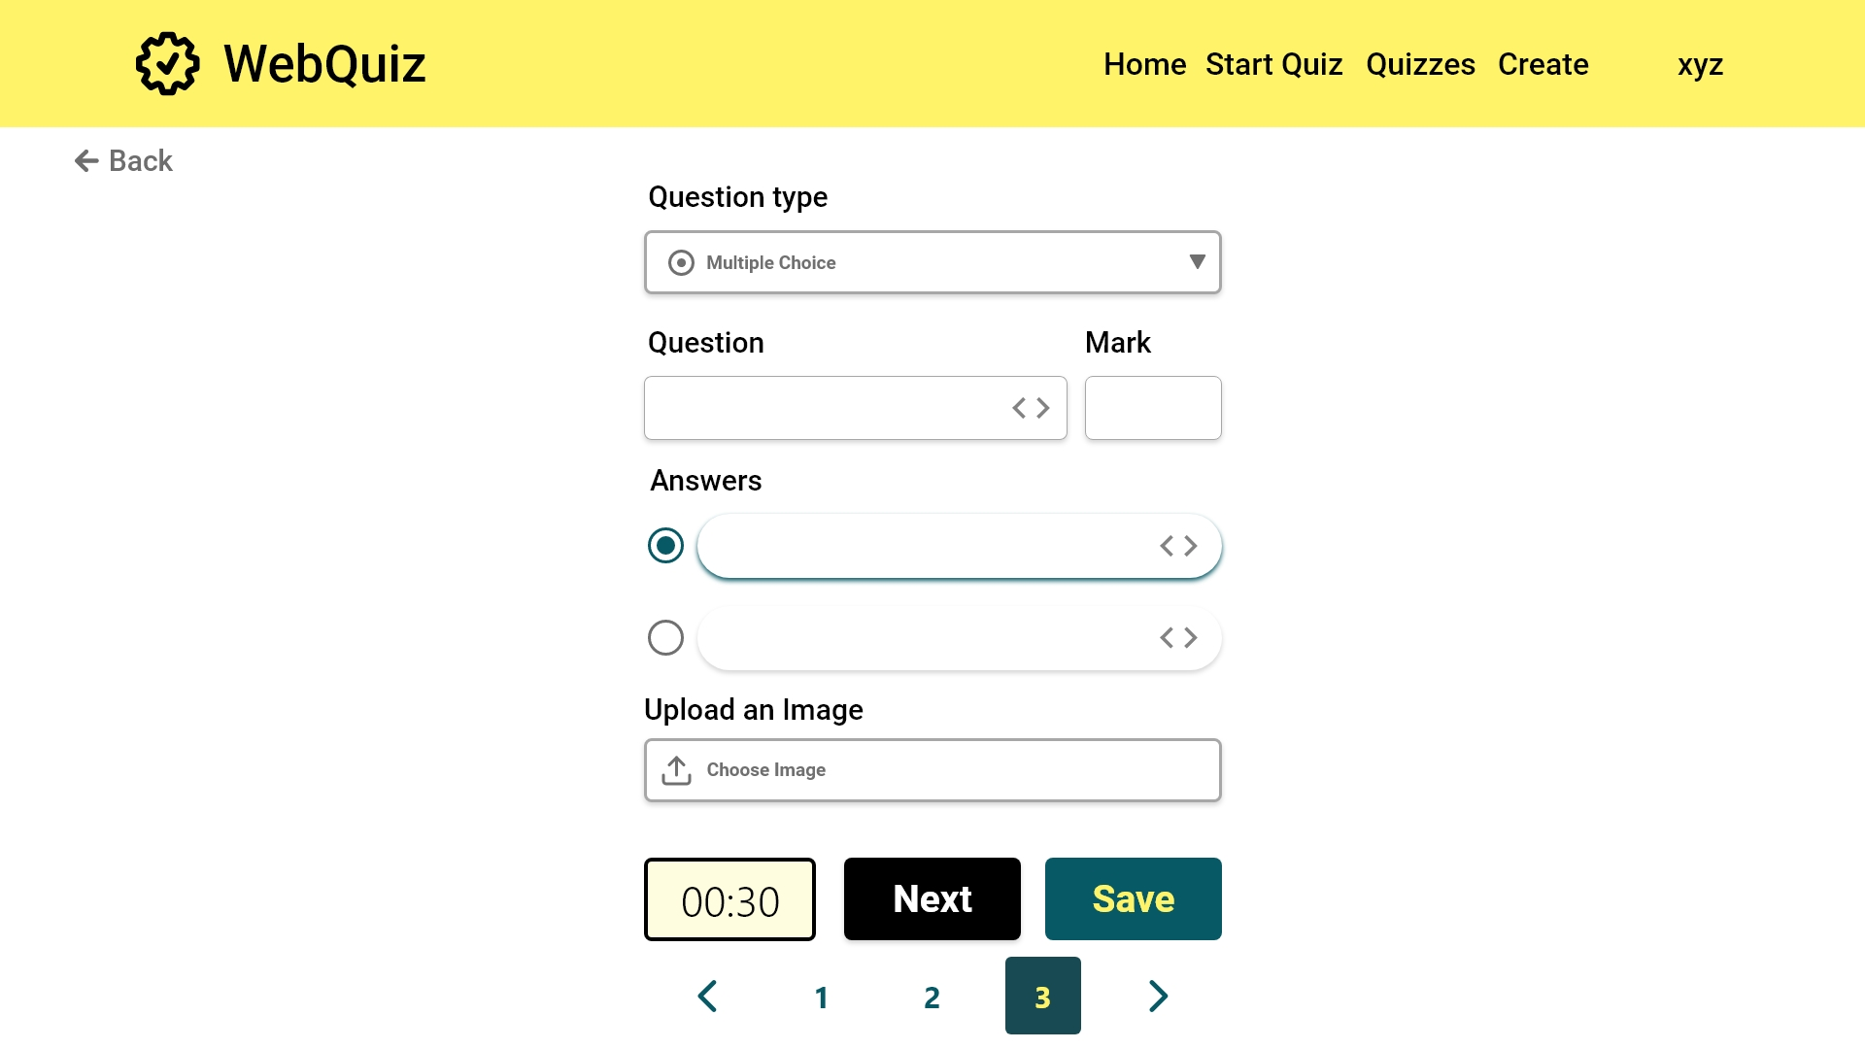
2 or more questions added. The save button becomes available

Slide 49


Slide 50


Slide 51
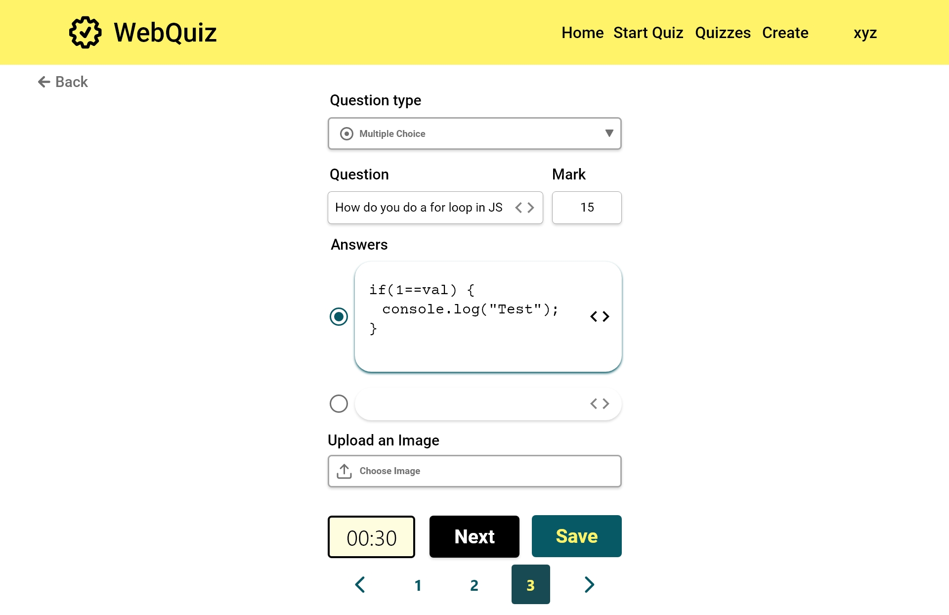

Slide 52
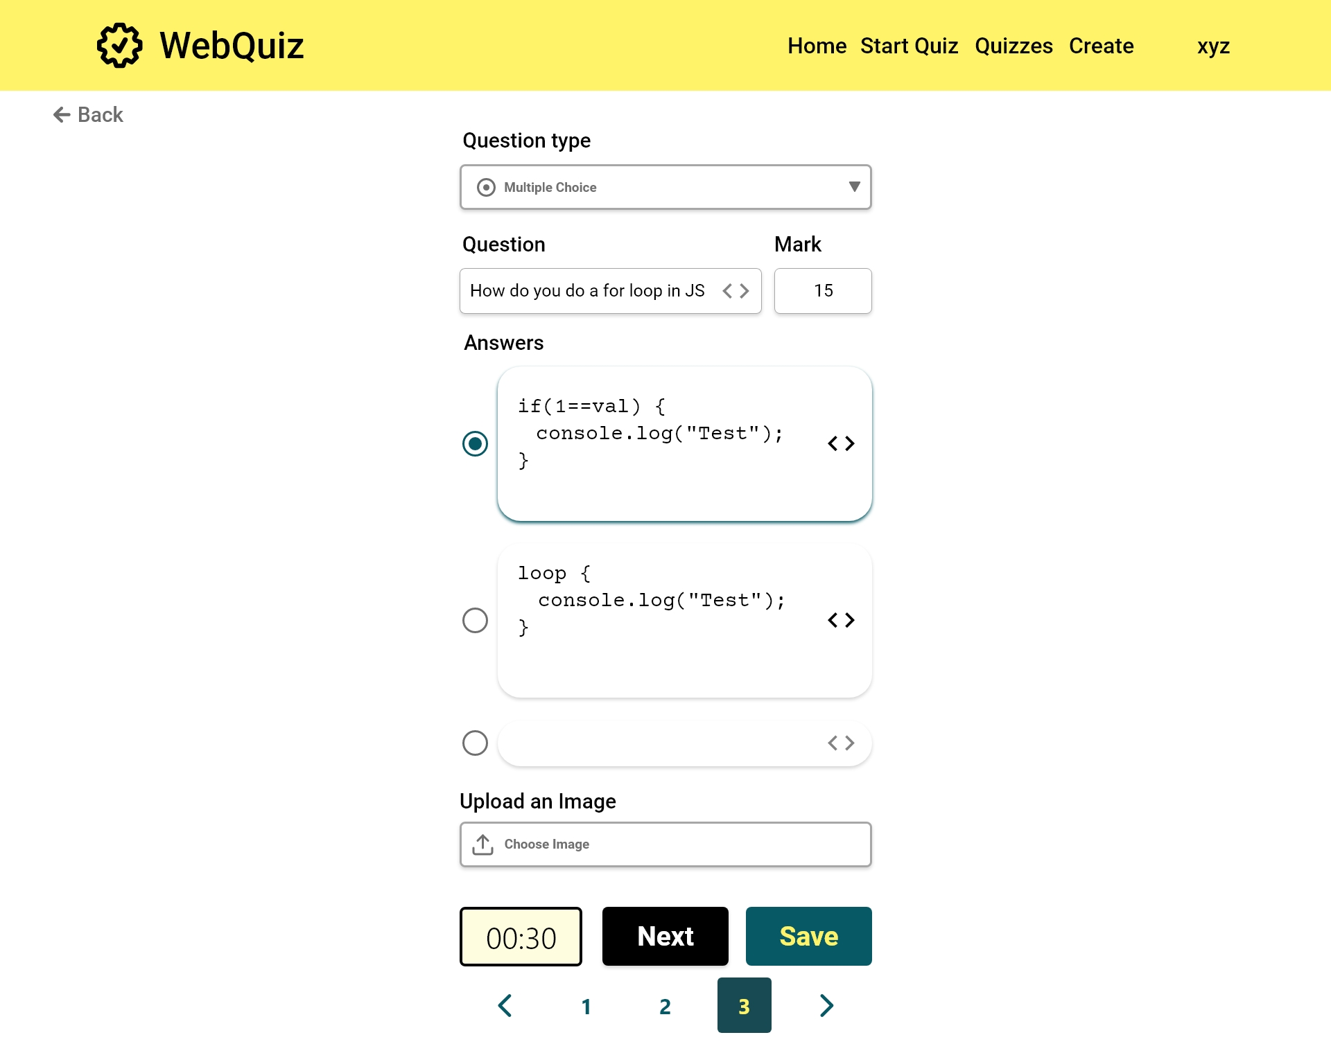

Slide 53
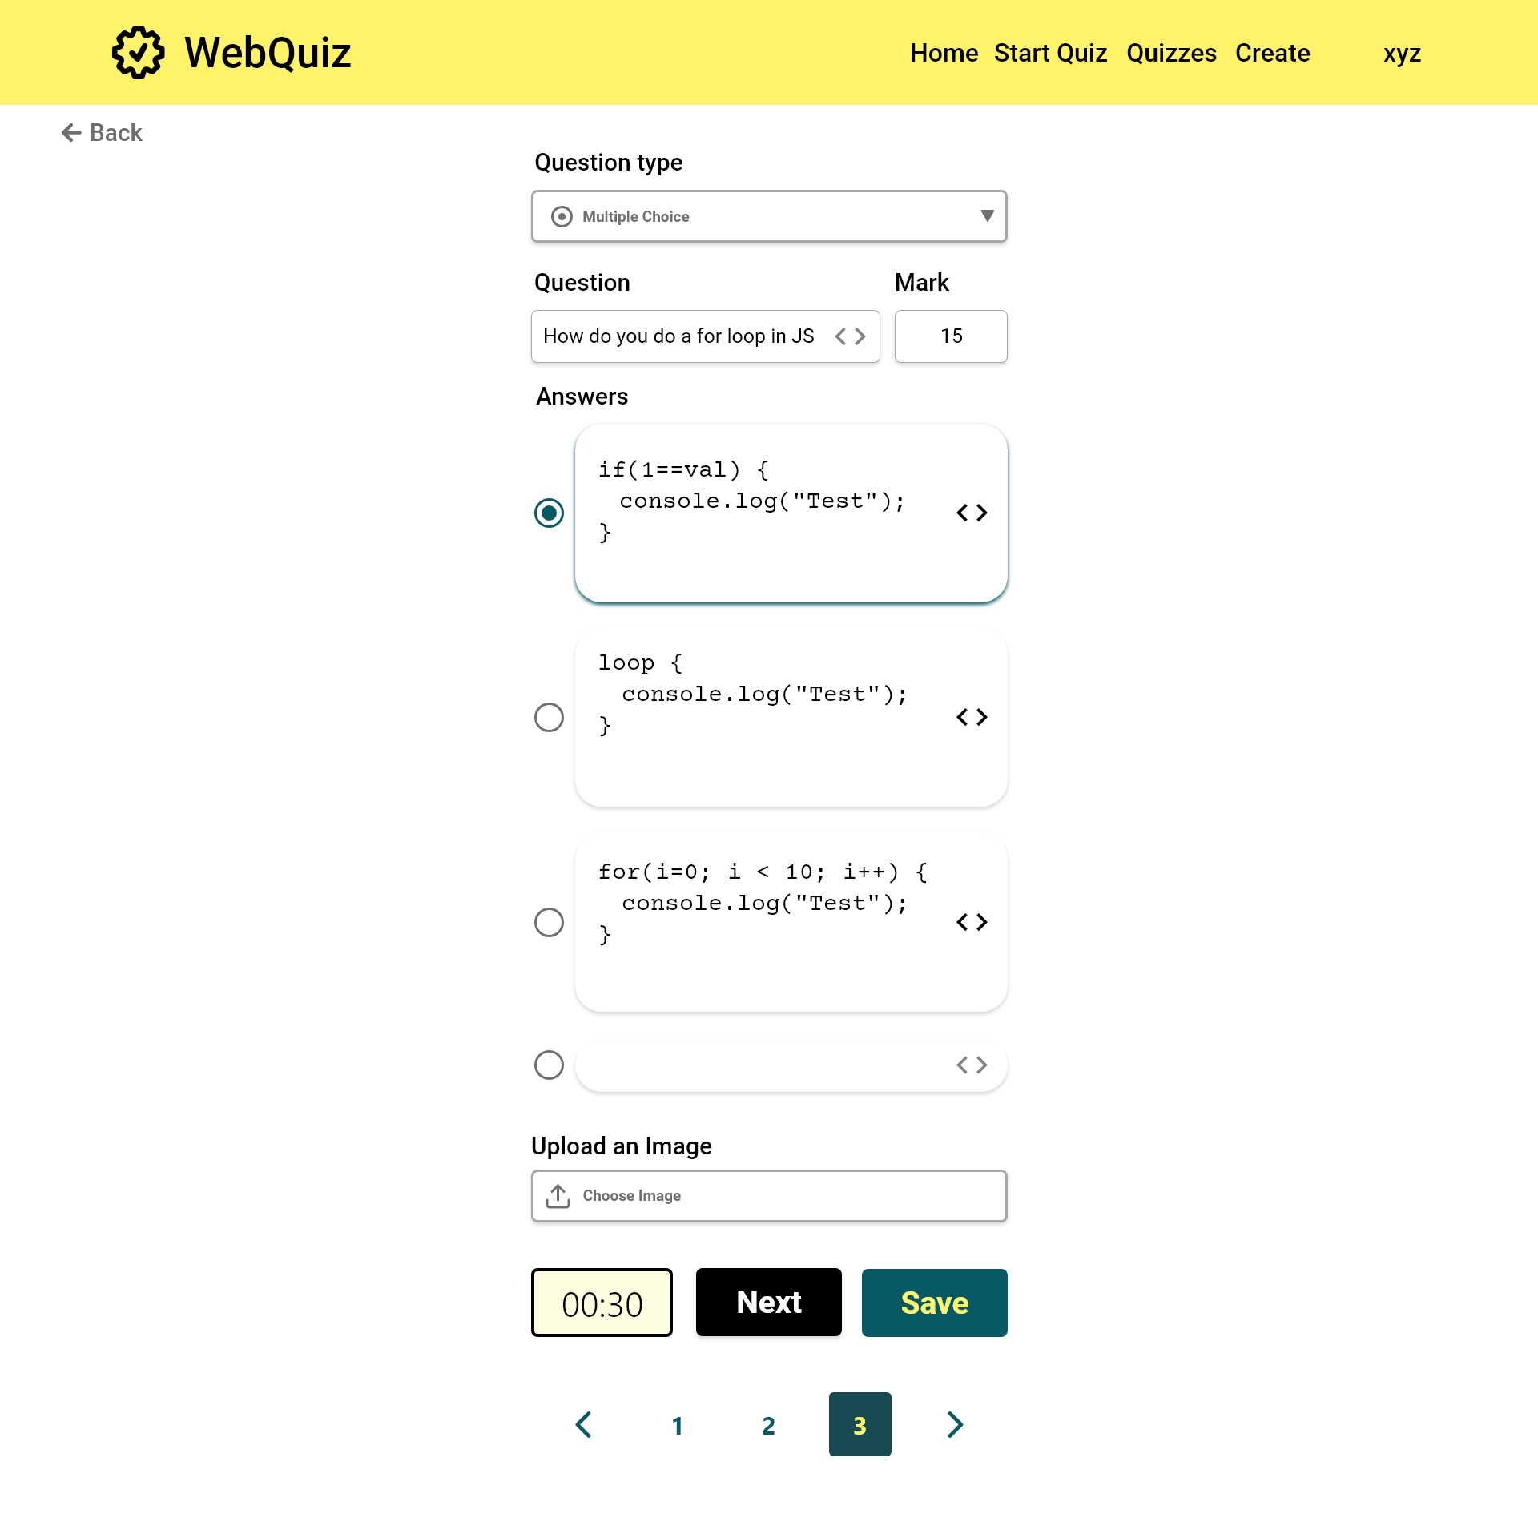

Slide 54
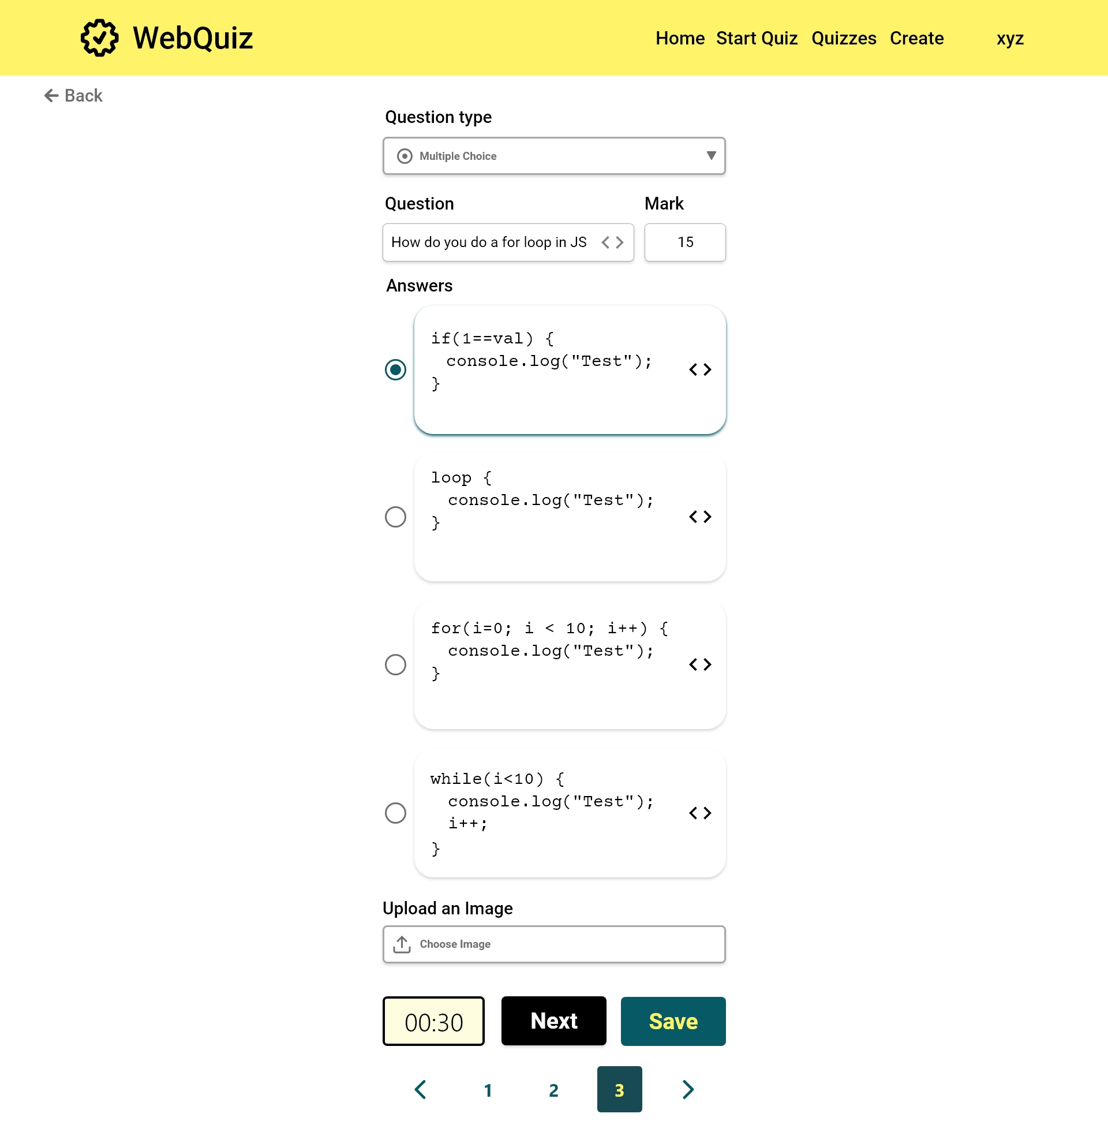

Slide 55
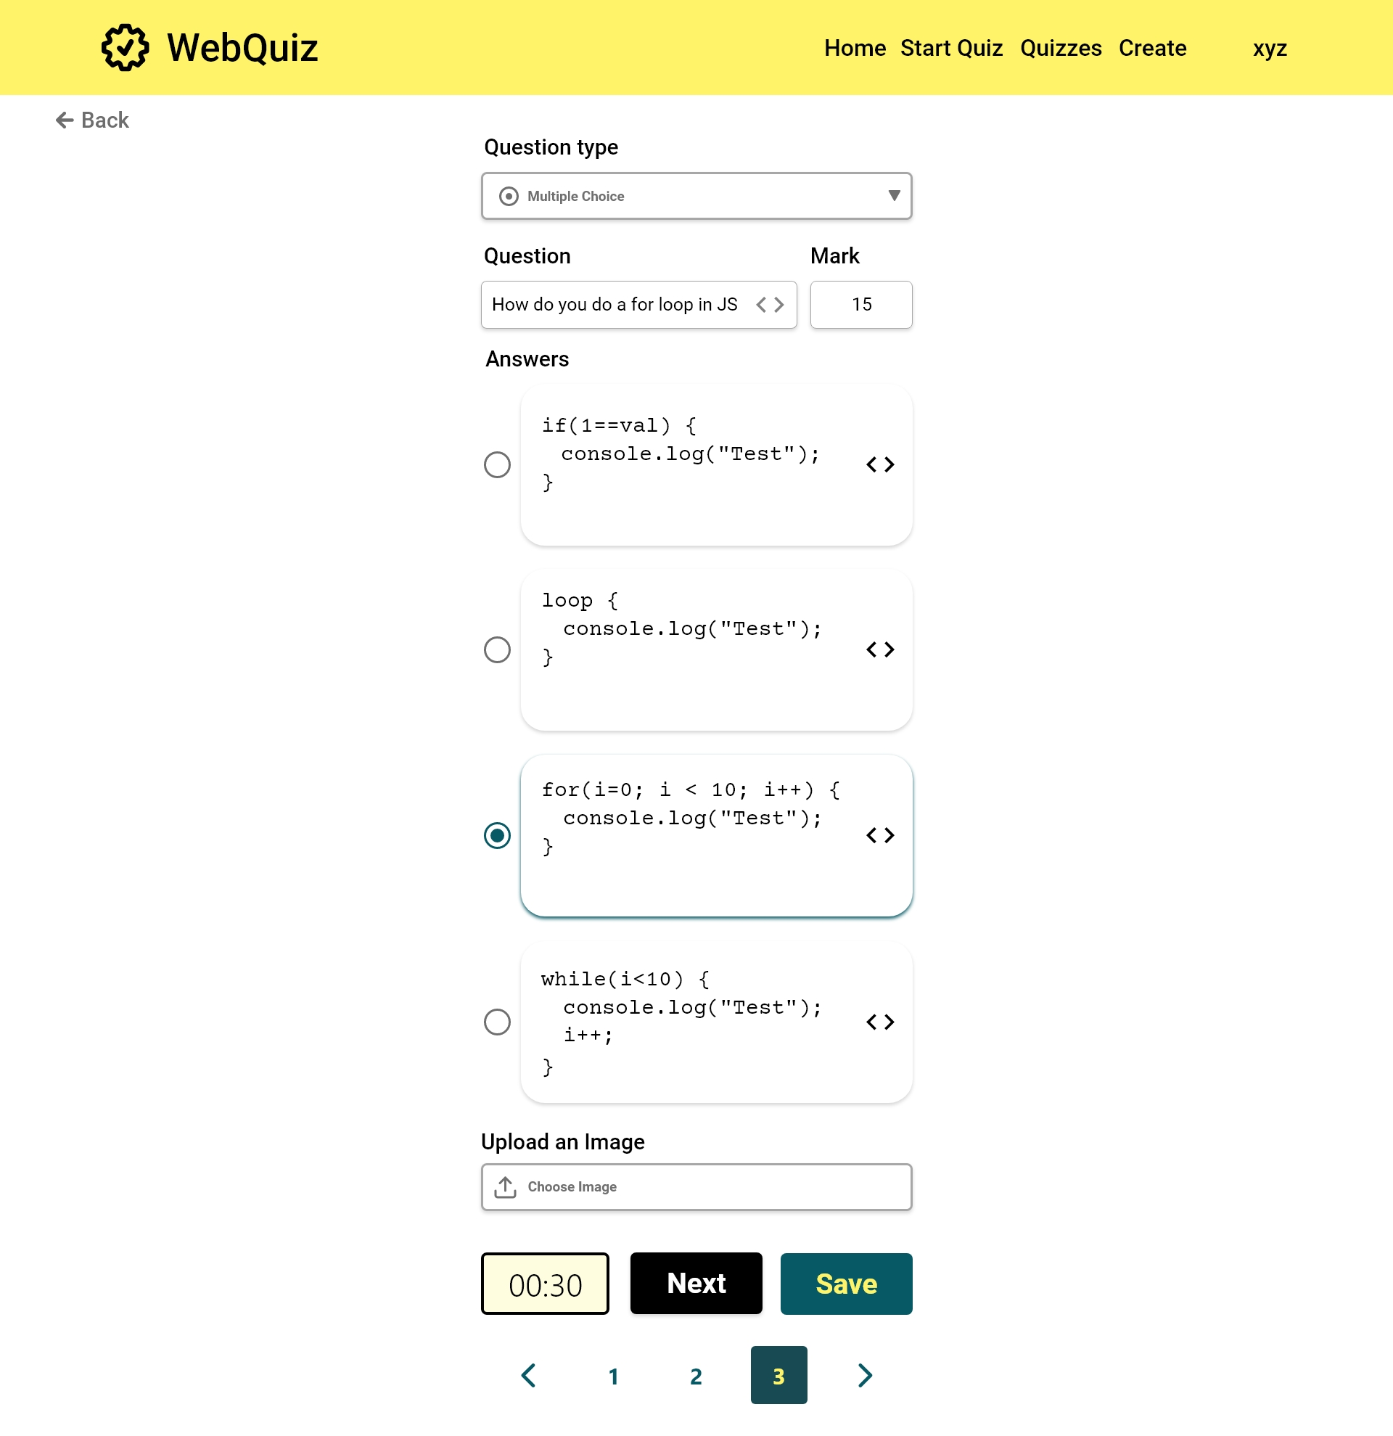

Slide 56


Slide 57


Slide 58
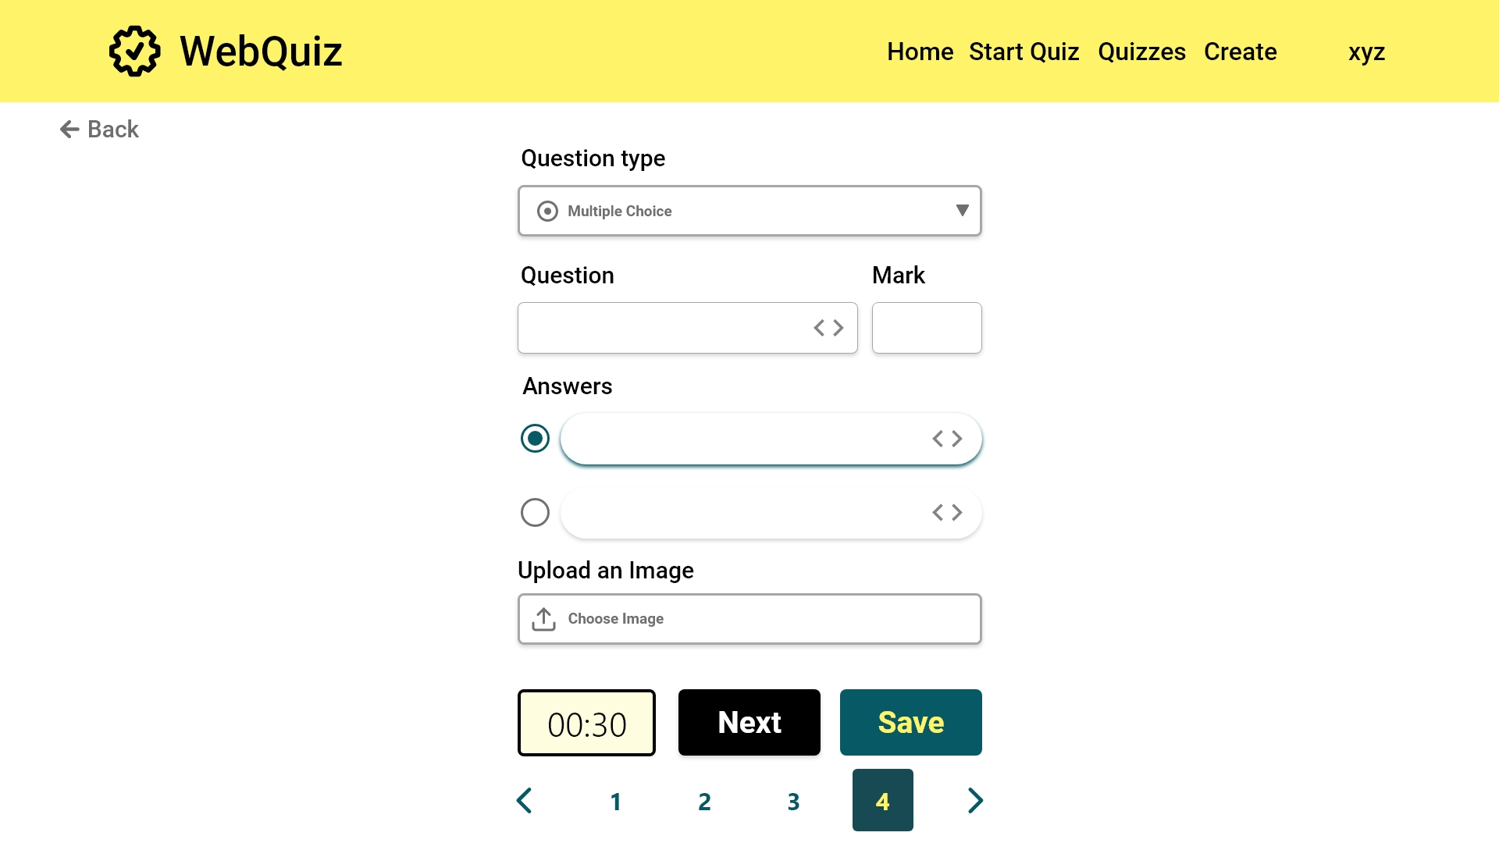

Slide 59
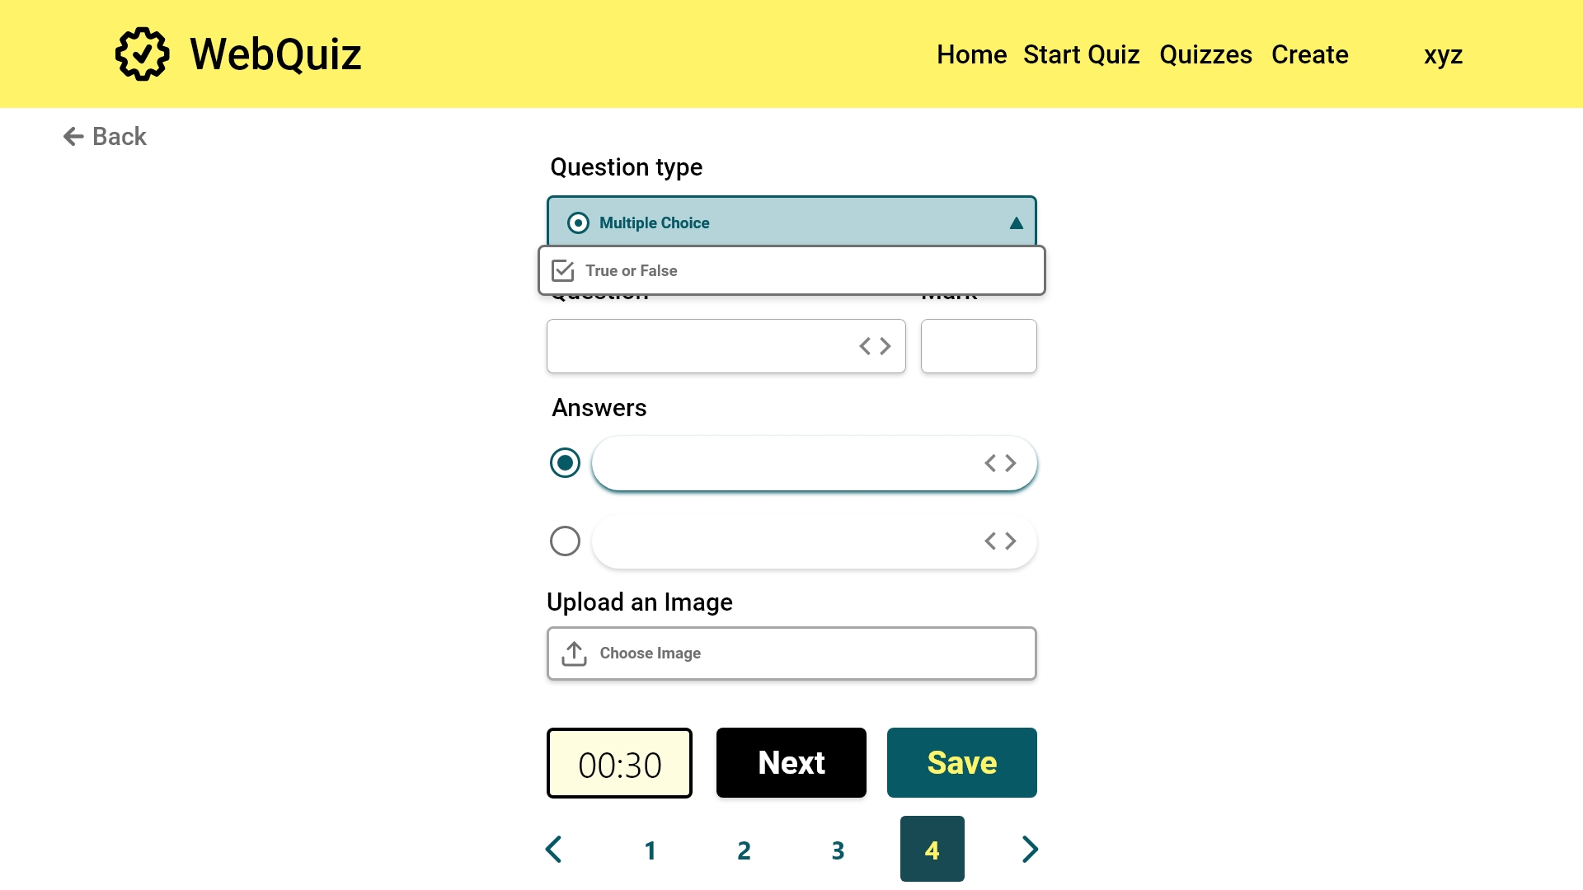

Slide 60
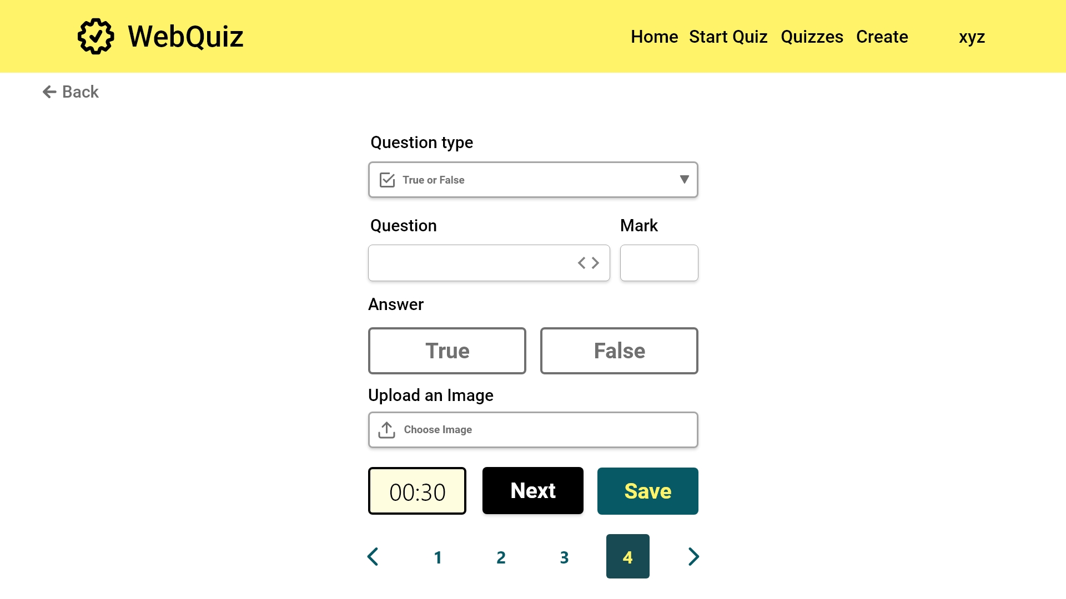

Slide 61
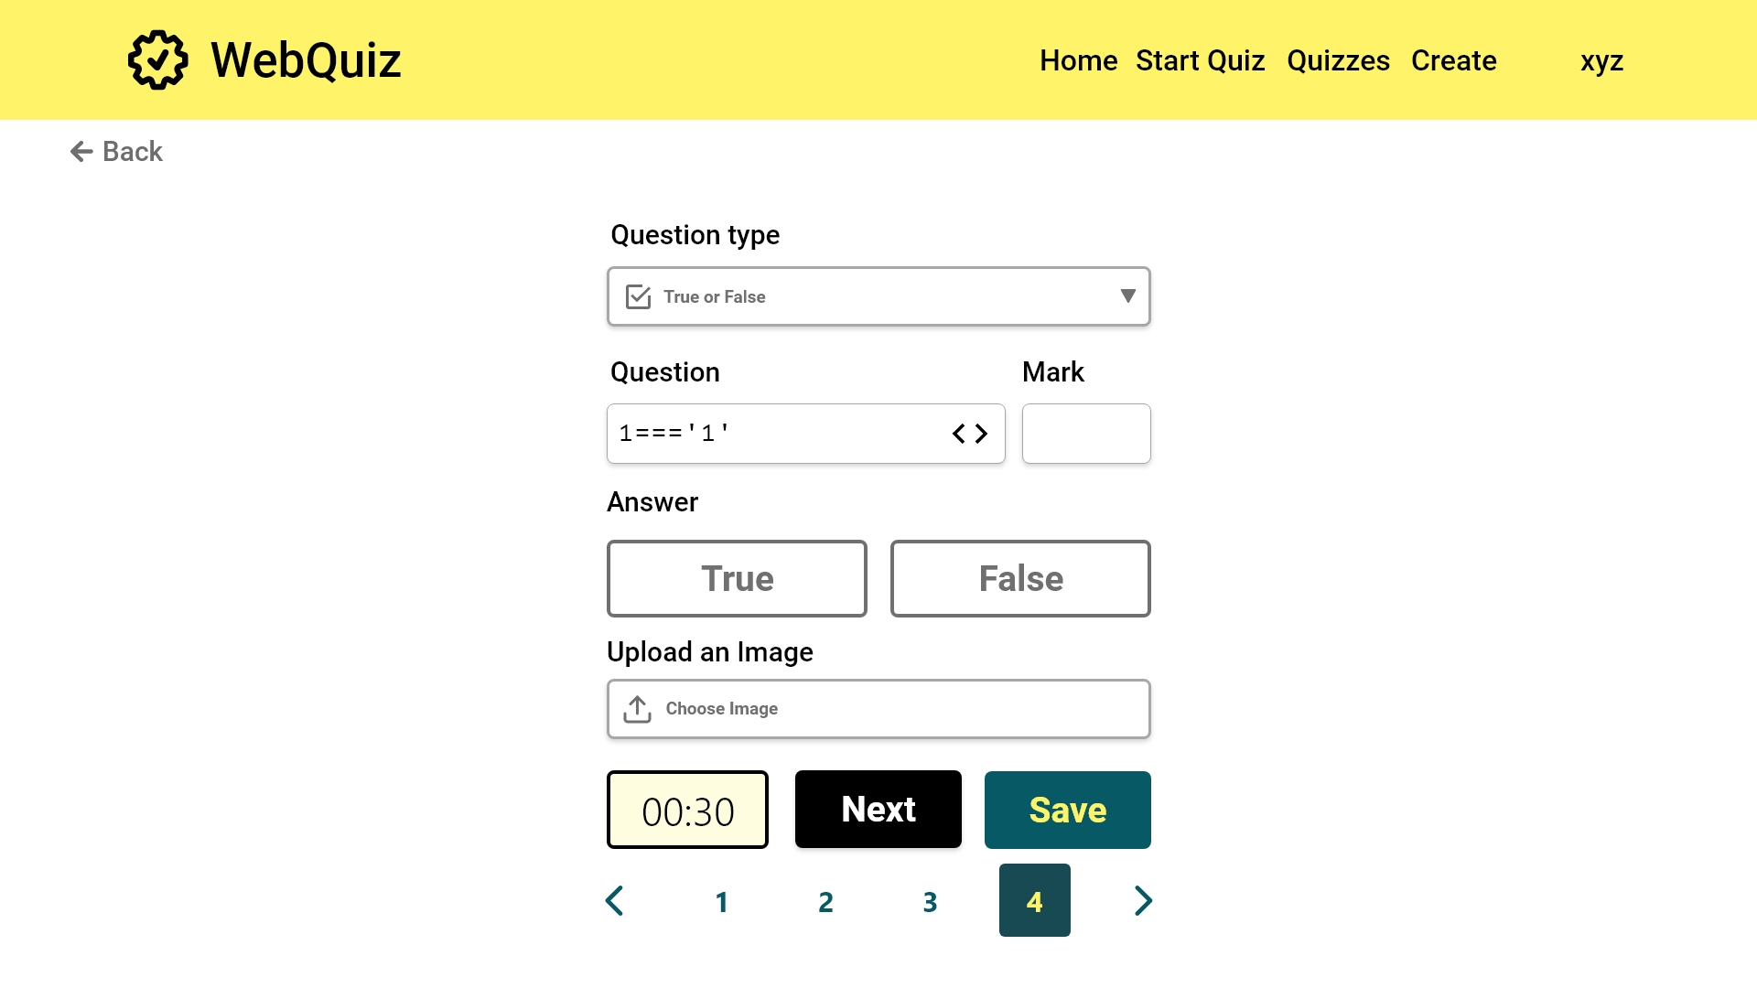

Slide 62


Slide 63
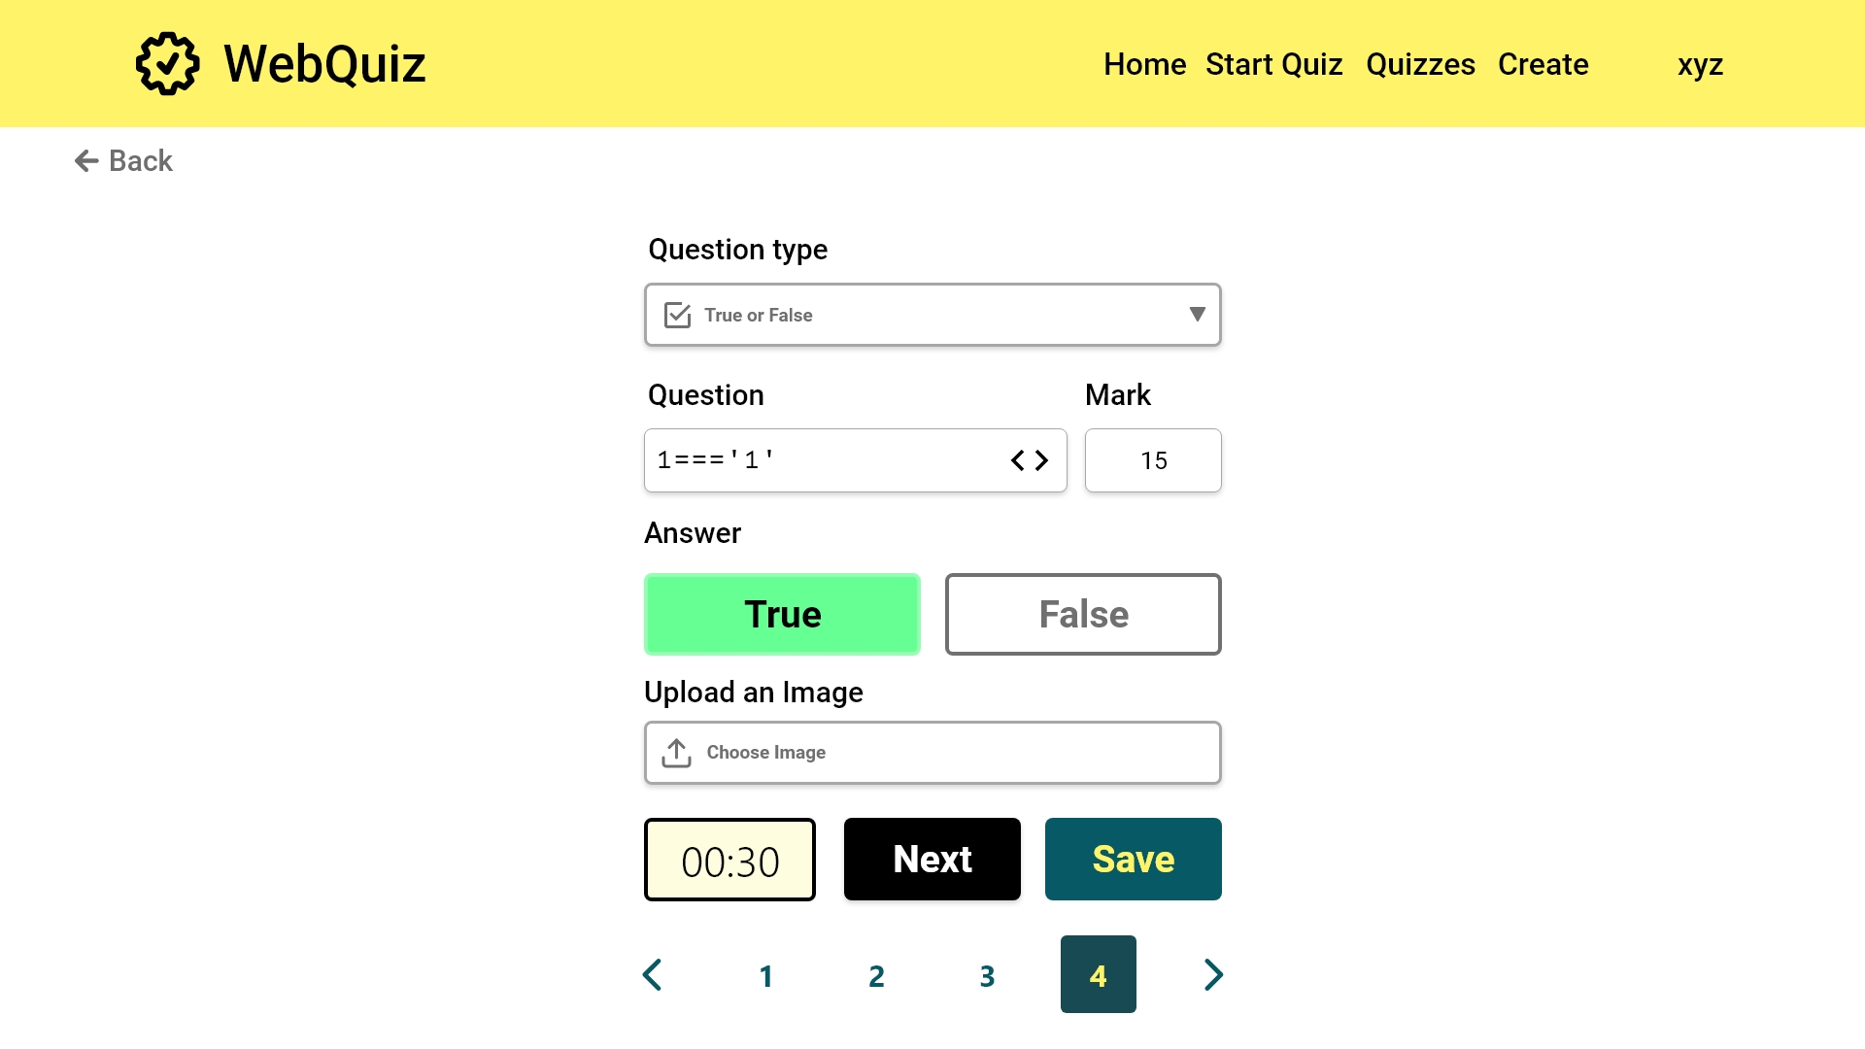

Slide 64
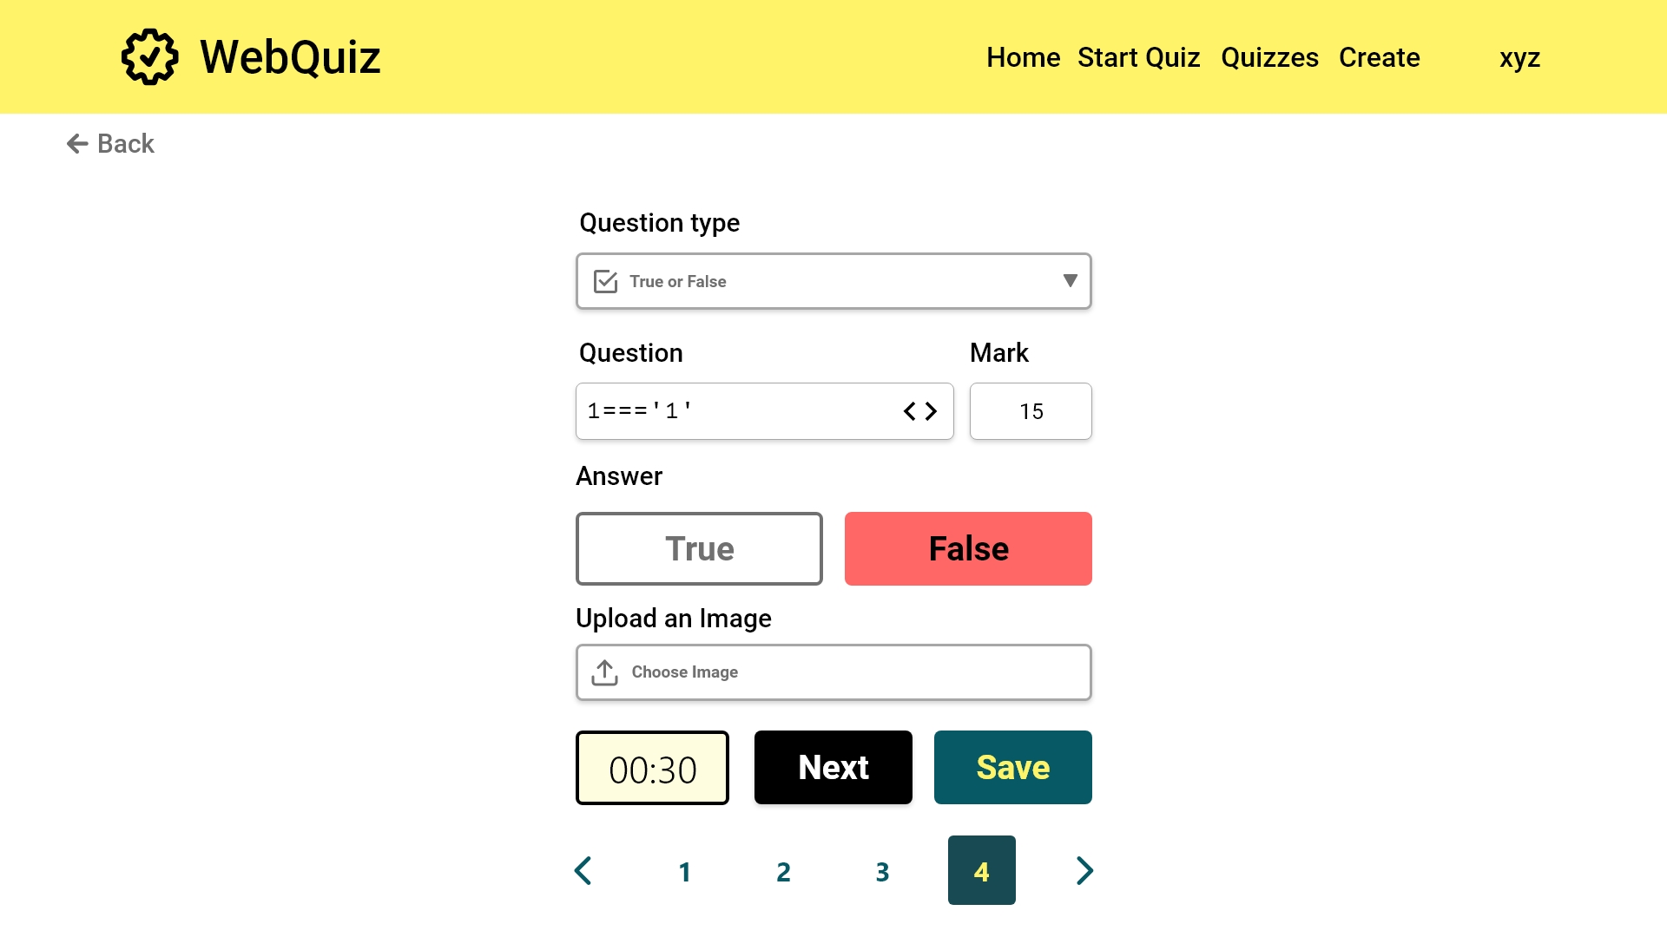

Slide 65


Slide 66
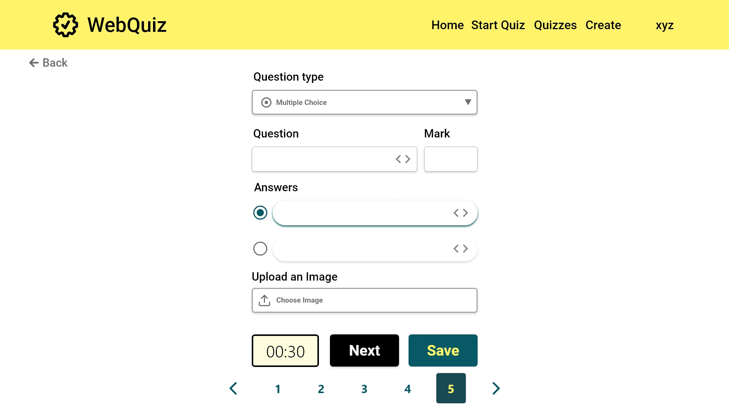
[FR7]: When the questions have been entered, this button will go to the preview screen

Slide 67
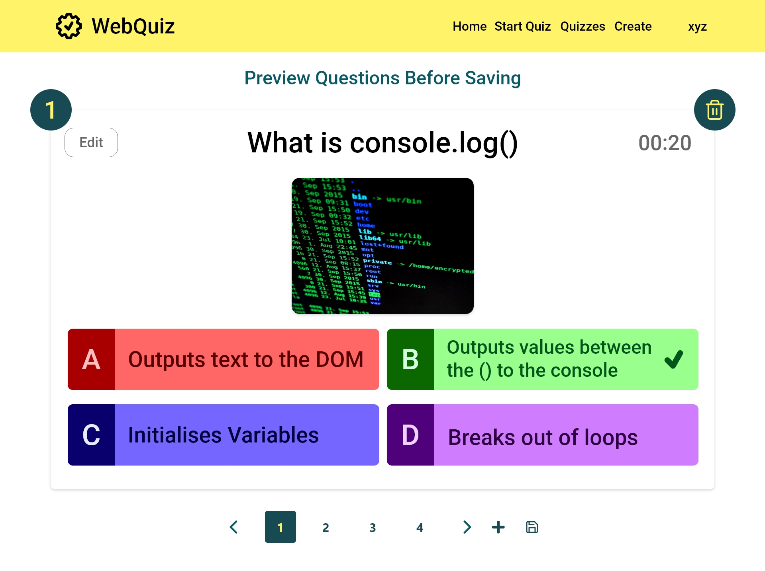
UC1.3
Quiz Maintainer preview quiz
[FR5]: A question can be deleted with this button
[FR6]: The quiz maintainer is able to edit a question here
[FR6]: The quiz maintainer can add more questions here
[FR7]: When the user is happy with the questions this button will save the quiz

Slide 68
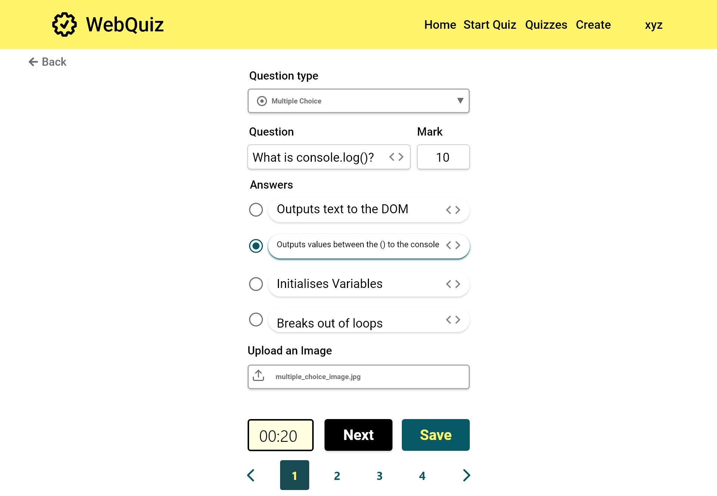
[FR6]: The quiz maintainer is able to edit a question here

Slide 69
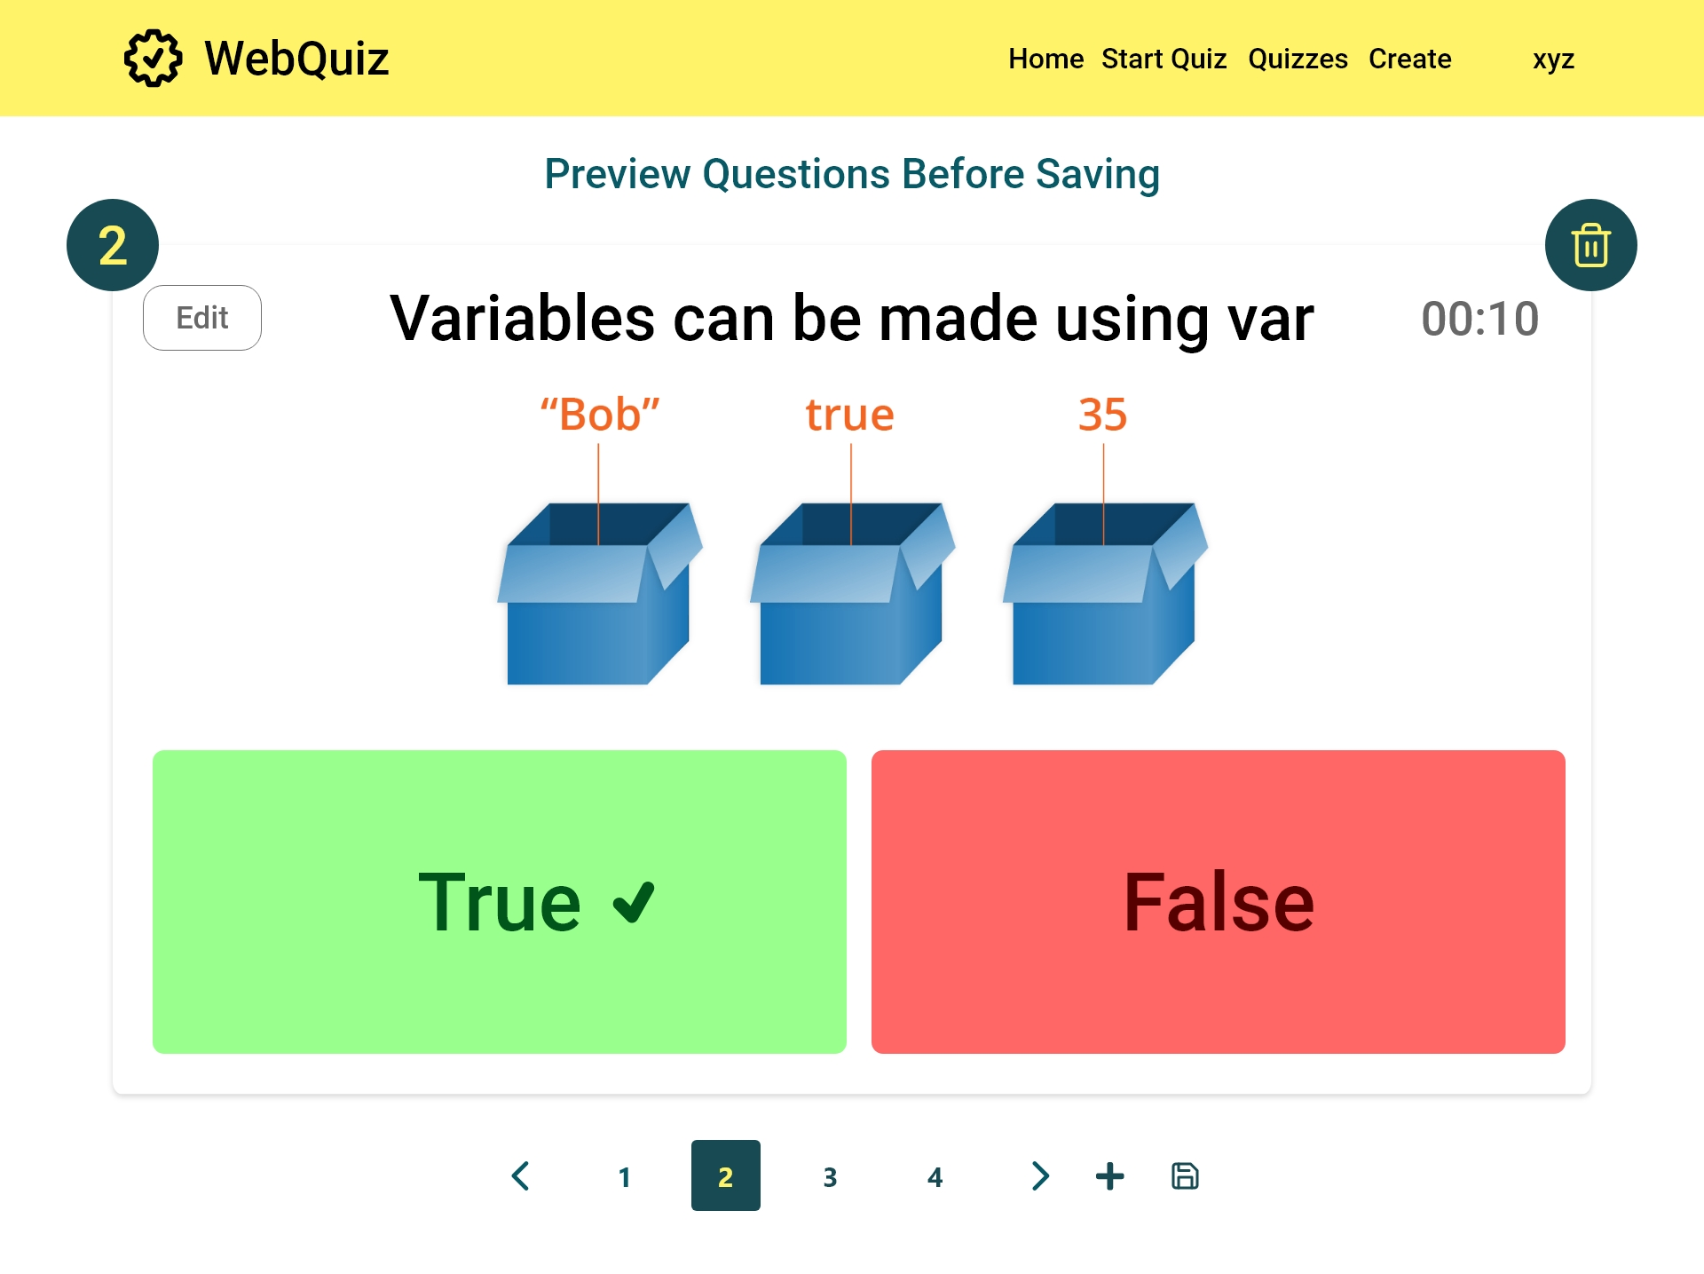

Slide 70


Slide 71


Slide 72


Slide 73


Slide 74


Slide 75

[FR5]: Once the delete has been committed, it can be undone

Slide 76
Quizzes

Slide 77

[FR8]: The questions can be sorted alphabetically or by date
UC1.4
Quiz Maintainer view quizzes
[FR8]: All created quizzes are listed here. These can be edited or deleted as needed.
Edit quiz
UC1.5
Quiz Maintainer edit quiz
[FR19]: Quiz Maintainer can export quiz.
[FR9]: Quiz Maintainer can provide a link to Quiz Master to start a quiz.
UC1.6
Quiz Maintainer delete quiz
UC2.2
Quiz Master view quizzes
[FR20]: The user can import a previously created quiz here

Slide 78


Slide 79


Slide 80


Slide 81


Slide 82


Slide 83

[FR20]: The user can import a previously created quiz here

Slide 84


Slide 85

Delete Quiz

Slide 86
Start Quiz Menu

Slide 87

UC1.7
Quiz Maintainer start quiz
[FR13]: As a quiz master, this button can be used to start the quiz when ready
UC2.3
Quiz Master start quiz
[FR20]: A quiz can be imported as a quiz master also

Slide 88
Start Quiz

Slide 89

[FR12]: The quiz master can enable or disable the timer
[FR10]: A code is generated that quiz participants can use to join
[FR13]: When all participants have arrived the quiz master can start the quiz
UC2.3
Quiz Master start quiz
Change between
participant and Quiz Master

Slide 90

Change between
participant and Quiz Master

Slide 91

[FR17]: The quiz participant can use the link and code to join the session
UC3.0
Quiz Participant join quiz
Change between
participant and Quiz Master

Slide 92
Question 1

Slide 93

UC2.3
Quiz Master start quiz
[FR11]: Viewing a shared screen that shows question and possible answers.
[FR14]:Quiz master can manually step through the questions
Change between
participant and Quiz Master

Slide 94

Change between
participant and Quiz Master

Slide 95
Participant view Question 1

Slide 96

[FR17]: A running multiple choice quiz as it appears to a participant
UC3.1
Quiz Master taking quiz
[FR18]: A participant can choose to separate the questions and answers
Switch to mobile view
Change between
participant and Quiz Master

Slide 97

EIR2 Responsive web design
Switch to desktop view

Slide 98

Switch to desktop view

Slide 99

Change between
participant and Quiz Master

Slide 100

Change between
participant and Quiz Master

Slide 101

Change between
participant and Quiz Master

Slide 102
Question 2

Slide 103

[FR17]: A running true or false quiz as it appears to the quiz master
[FR14]: The quiz master can step through the quiz as needed
[FR15]: A running quiz can be stopped if necessary
Change between
participant and Quiz Master

Slide 104

Change between
participant and Quiz Master

Slide 105
Participant view Question 2

Slide 106

[FR17]: A running true or false quiz as it appears to a participant
Switch to mobile view
Change between
participant and Quiz Master

Slide 107

Switch to desktop view

Slide 108

Switch to desktop view

Slide 109

Change between
participant and Quiz Master

Slide 110

Change between
participant and Quiz Master

Slide 111

Change between
participant and Quiz Master

Slide 112
Question 3

Slide 113

Change between
participant and Quiz Master

Slide 114

Change between
participant and Quiz Master

Slide 115
Participant view Question 3

Slide 116

Change between
participant and Quiz Master

Slide 117

Change between
participant and Quiz Master

Slide 118

Change between
participant and Quiz Master

Slide 119
Change between
participant and Quiz Master

Slide 120
Question 4

Slide 121

Change between
participant and Quiz Master

Slide 122

Change between
participant and Quiz Master

Slide 123
Participant view Question 4

Slide 124

Change between
participant and Quiz Master

Slide 125

Change between
participant and Quiz Master

Slide 126

Change between
participant and Quiz Master

Slide 127

Change between
participant and Quiz Master

Slide 128
Results

Slide 129

[FR16]: At the end of the quiz an individual score will be given

Slide 130


Slide 131


